Slide 1

Lesson: Allah is the Creator of the Universe

Slide 2





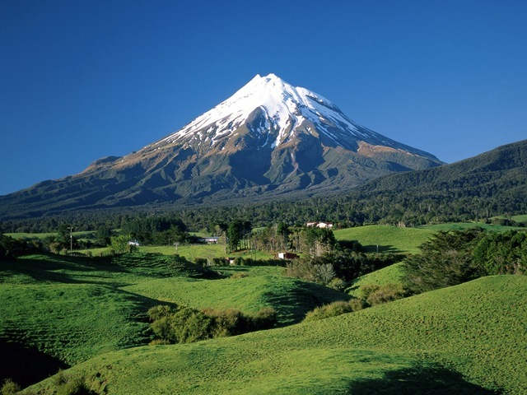
Natural and Man-made things

Slide 3
Why are man-made things made?
Why do natural things exist?
What is the difference between them?

Slide 4
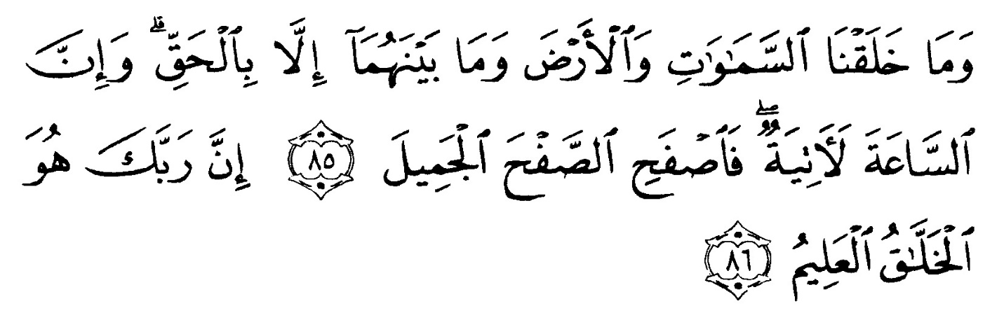
Surah # 15
Ayah # 86
Surah e Hijr
“Indeed, your Lord is the Creator of everything, The All Knowing.”

Slide 5
Surah # 2
Ayah # 164
Surah # Baqarah
“Indeed in the creation of the heavens and the earth, and the alternation of night and day, and the ships that sail at sea with profit to men, and the water that Allah sends down from the sky, with which He revives the earth after its death, and scatters therein every kind of animal, and the changing of the winds, and the clouds disposed between the sky and the earth, are surely signs for a people who apply reason.”

Slide 6




Buoyancy
Clouds
Earth
Change of day and night

Slide 7

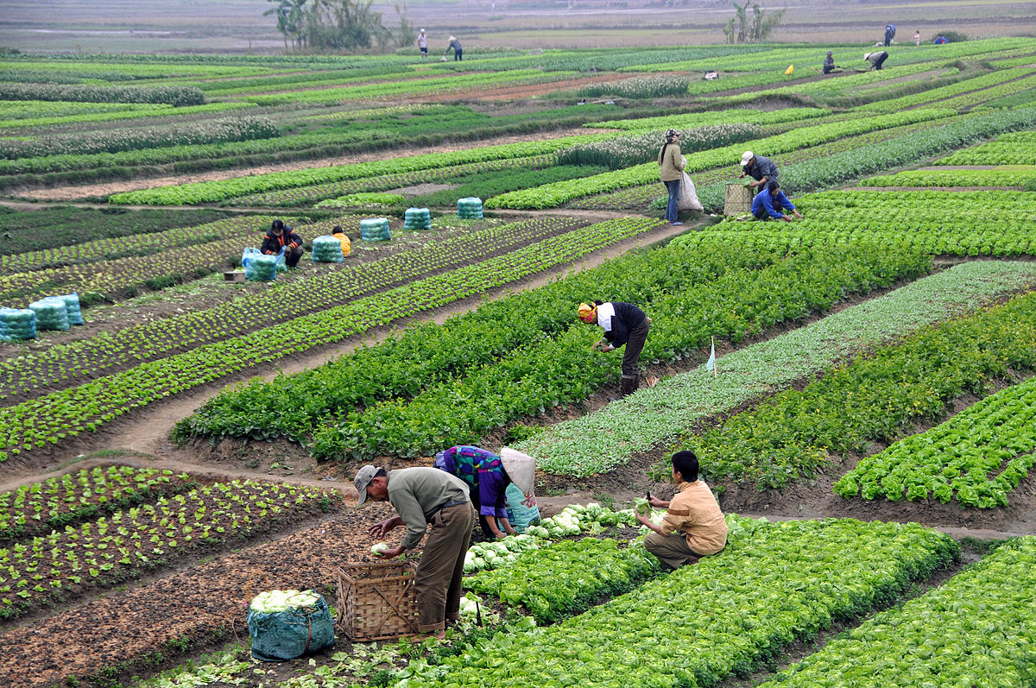
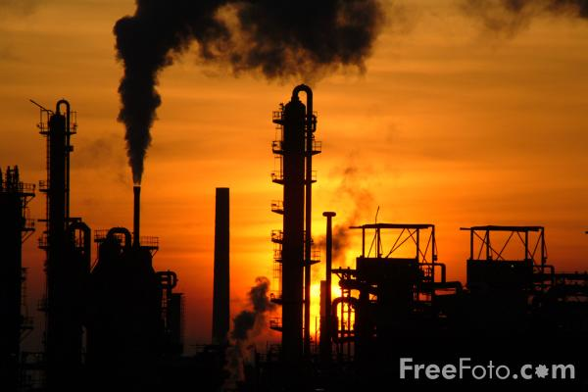
Earth (land, water, air, fire)
Land
vast
housing
agriculture
industry

Slide 8
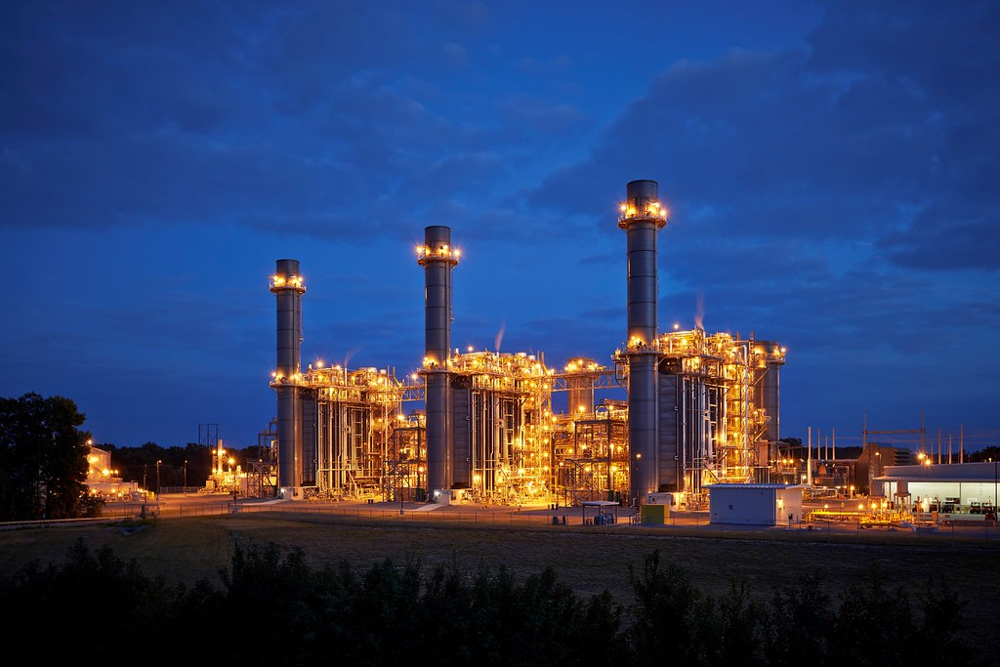
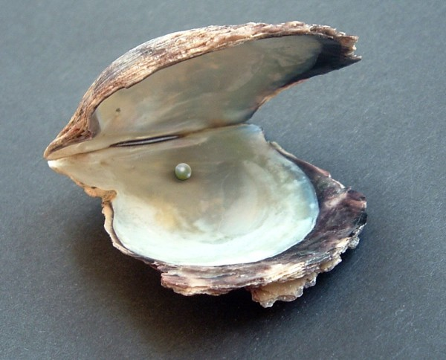

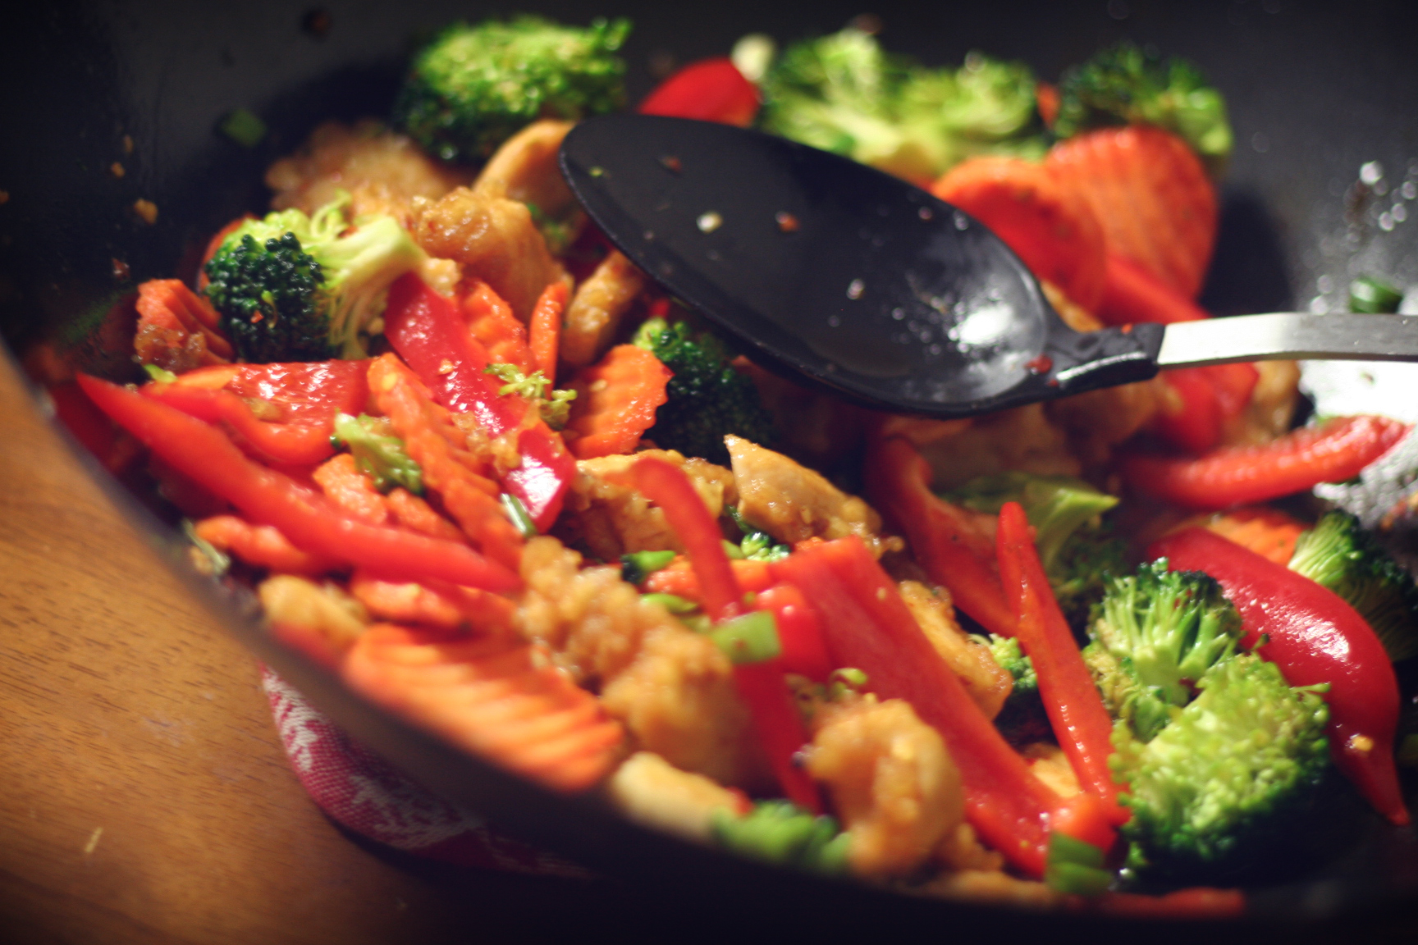
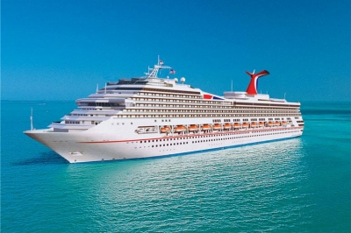
Water

Slide 9

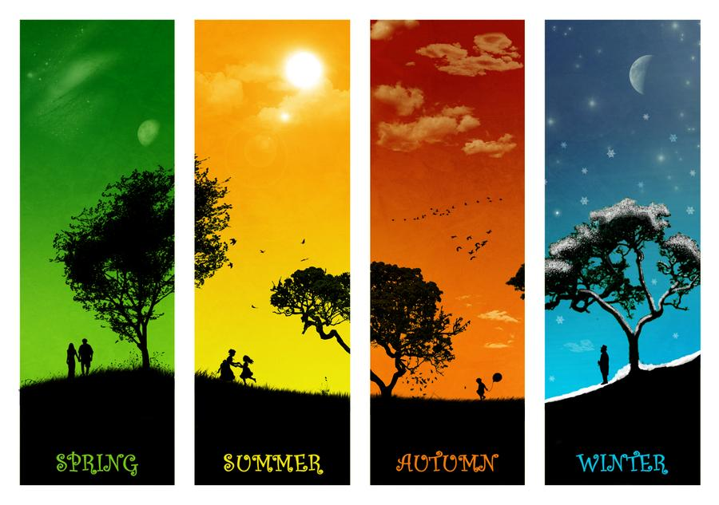


Air

Slide 10

Fire
Provides light
Keeps us warm
Enables to cook food
Making bricks and pottery
Generates electricity

Slide 11
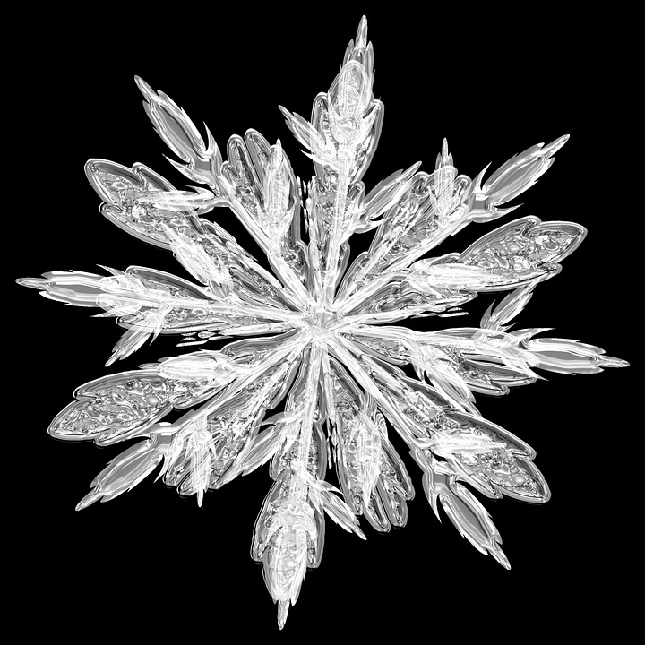

Clouds
Hadis e Qudsi: “I have created
everything
for you, but I created you for Me.”

Slide 12
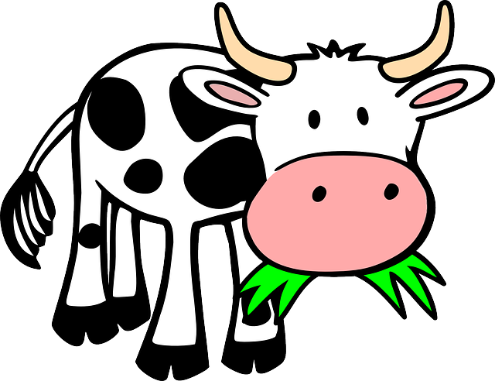


CHANGE OF DAY AND NIGHT:
(humans, plants, animals)

Slide 13
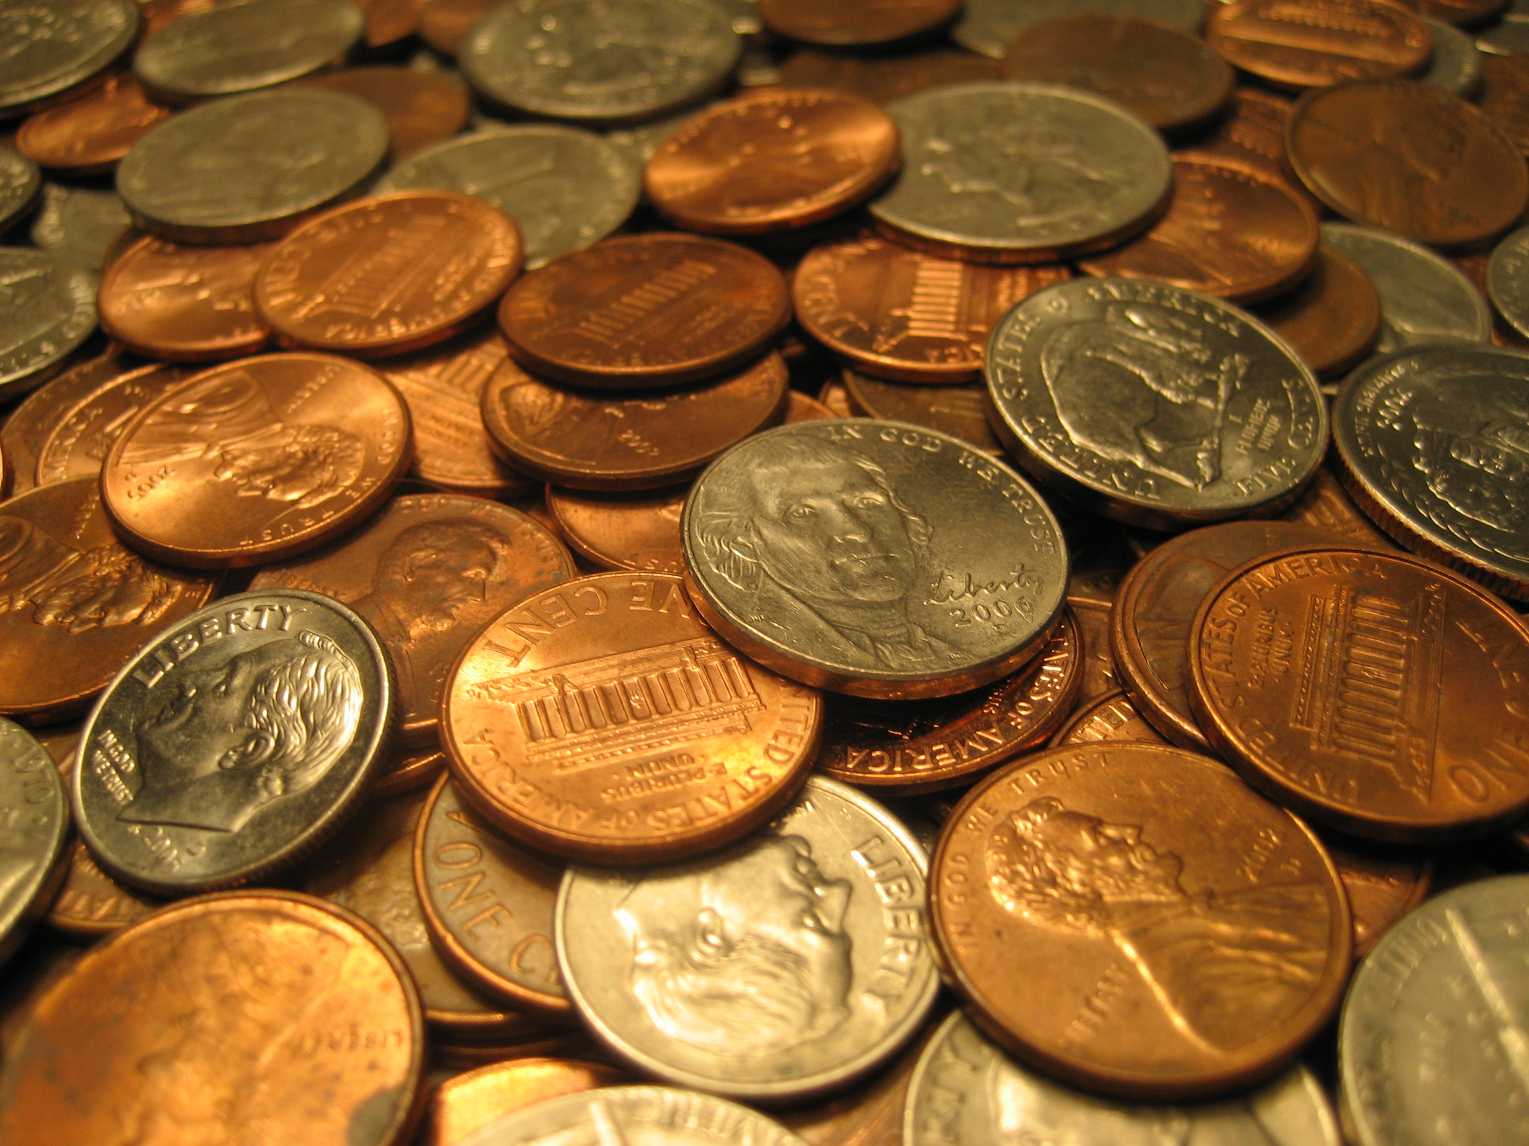
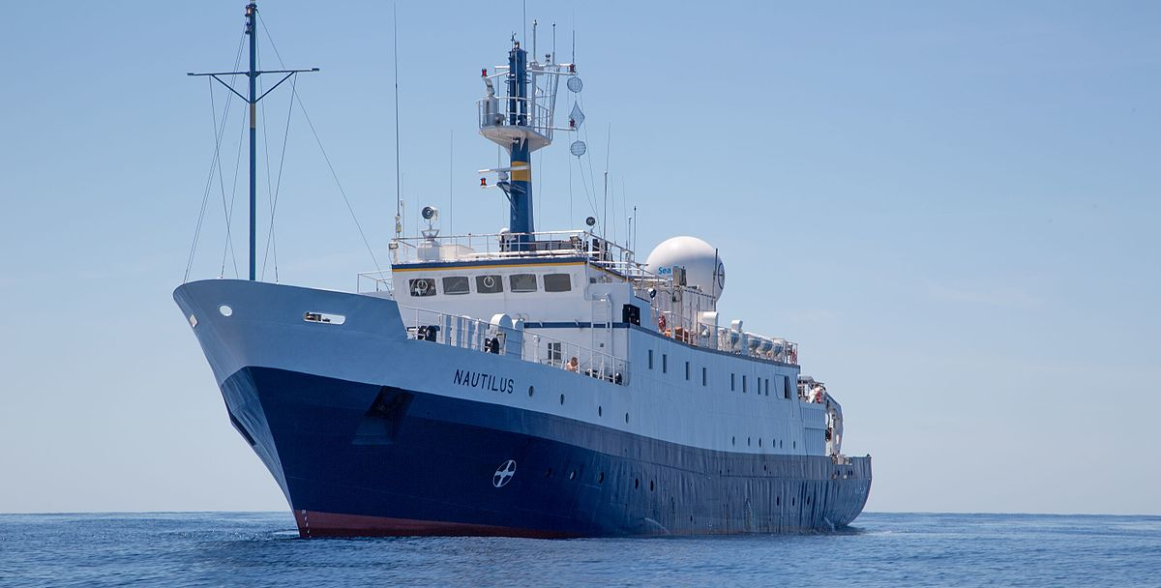
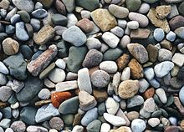
BUOYANCY: ability to float
Experiment

Slide 14
To conclude:
Imam Ali (a.s) said: “How wonderful is man that he sees with fat (the eye), talks with a piece of flesh (tongue), hears with a bone (inner ear) and breathes through a hole (nose).”

Slide 15
HOMEWORK:
1. Find three ayahs from the Quran beginning with “Among His signs” Mention name of surah, ayah number and English translation of the ayah.
2. Which is surah number 59? It has few of Allah’s attributes (qualities). Example: Al-Baari: the Inventor; the Originator
Other than this, write three other attributes along with their meaning.
3. Every hardship brings a blessing. Elaborate the statement with an example related to our topic.

