Slide 1
Allah is everywhere, knows everything and he is the most powerful
LESSON 1A03
Notes:
Note: this is a more hands on lesson and doesn’t require a lot of use of the presentation. Most of it is making students understand by actions

Slide 2
LEARNING OBJECTIVES
- To recognize that Allah is everywhere
- To point out that Allah knows everything
- To discover that Allah is the most powerful

Slide 3
https://madrasahonline.org/resource/1a03_lo1_misri-bunch-video/
Notes:
Start by a mini review of last weeks lesson and then ask: ‘Did any of you call out to Allah during the week?’ Allow students to answer but move quickly from one to the other so that all those who want to contribute can get a word in. Ask this question: ‘If I go far, far away into a desert and call out to Allah, will He hear me?’ They should respond: ‘Yes.’ Then ask: ‘What if I go deep into the ocean, all the way down? Will He hear me then?’ They should all answer: ‘Yes.’ Then ask: ‘Can Allah see me everywhere too?’ Listen to their answers, then say: ‘Let’s watch a video about three little squirrels before we answer that question.’ VIDEO LINK IN THE SLIDE
Play the video. The video ends with a question: does this mean Allah is everywhere? The students will all respond: ‘Yes!’ Then ask them: ‘How is He everywhere? Does He have hands and legs? Is He very, very big so that He can be everywhere?’ The students may look confused and some may answer ‘yes’ while some may say ‘no’. Then explain slowly: ‘Allah does not have a body like us, so this means He is not in any one place. He is everywhere.’ Spread your arms wide. ‘This means that He hears us and sees us everywhere.’ Spread your arms wide again.

Slide 4
SO WHEREVER YOU TURN, ALLAH IS THERE ( SURAH bAQARAH )
The Quran says….
Notes:
Explain that the Qur’an tells us: fa aynama tuwallu fa thamma wajhullah – so wherever you turn, Allah is there.
Break up the ayah and let the children repeat after you: fa aynama – tuwallu – fa thamma – wajhullah.

Slide 5
Notes:
Play the rhyme and demonstrate the actions to your class. - The actions to the rhymes can be found on the MCE website, or linked here: https://madrasahonline.org/wp-content/uploads/2018/12/1A03_LO1_rhyme-actions.pdf

Slide 6
Is Allah All-Knowing?
Notes:
Start this activity by saying: ‘We now know that Allah hears and sees us everywhere, no matter where we are.’ Then ask: ‘Is Allah seeing that we are all at madrasah today?’ They will answer: ‘Yes!’ Ask: ‘Is Allah hearing us talk about Him right now?’ They will answer: ‘Yes!’ Ask: ‘Does this mean that Allah knows everything we do?’ They will most likely answer: ‘Yes!’
Take the discussion further by hiding an eraser in one of your hands, making sure the children did not see. Now put both fists forward and ask if Allah knows which hand the eraser is in. They will say: ‘Yes He does!’ Go further by showing them the picture of a pregnant mother. Ask them if they have ever seen a lady with a baby in her tummy. Then ask them if Allah knows whether the baby will be a boy or a girl and if He knows what colour the eyes and hair would be. They should answer ‘yes’ to all the questions.

Slide 7
The ALL KNOWING
Notes:
Now share that one of Allah’s beautiful names is al-Aleem – the all-knowing. He knows everything!

Slide 8
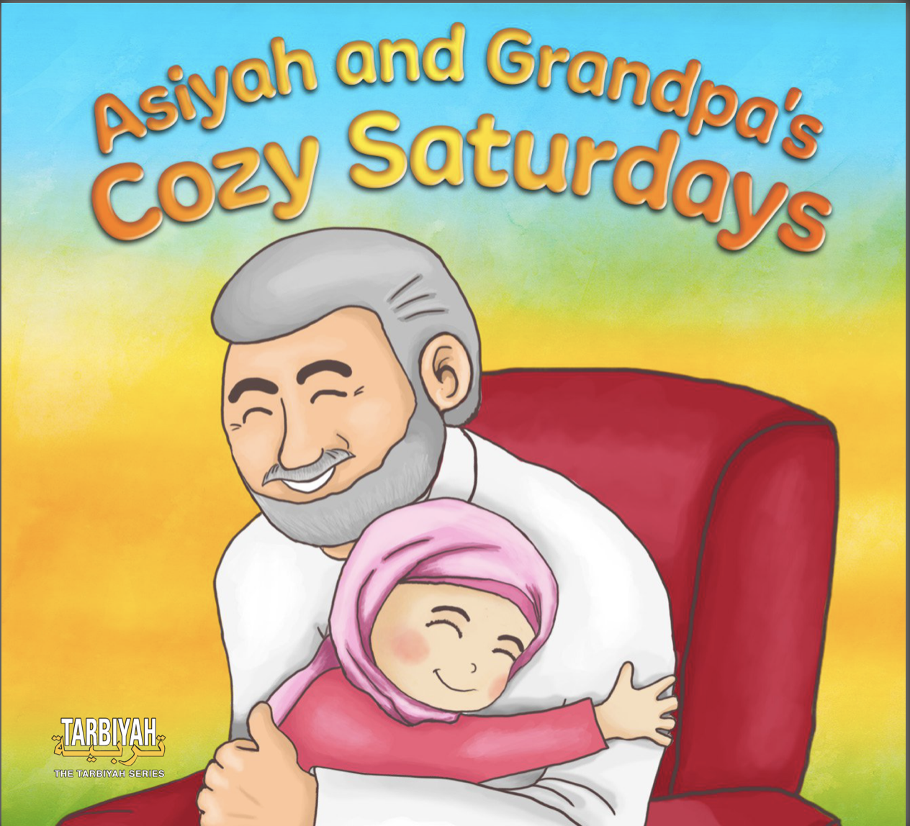
STORY TIME
https://madrasahonline.org/lessons/1a03-allah-is-everywhere-knows-everything-and-is-the-most-powerful/
Notes:
Read the story if you have the time

