Slide 1
Tarbiyah 1B04
Iblis the Proud One
Notes:
Audhubillah...Bismillah...Salawat
Salaamun Alaykum!

Slide 2
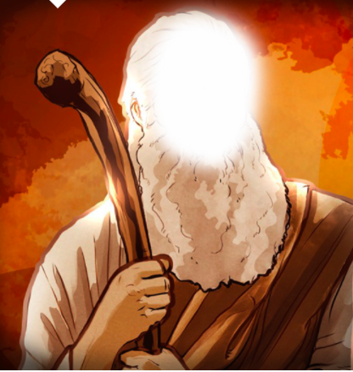
Nabi Adam
“I am better than Adam. You made me from fire, and you made Adam from normal clay. Fire is better than clay so I will not bow down to him.”
Iblis
Notes:
Who is Nabi Adam? Do you remember the story of Nabi Adam? (Allow students to share what they know and fill in the gaps)
Tell this story:
“Iblis was a Jinn, a creation of Allah made from smokeless fire. He lived happily in the heavens for many, many years with the angels. When Allah decided to create human beings, He told the angels about His plan. They asked Allah why He wanted to create humans who would destroy the beautiful earth that He had created. But Allah told them that He was Al-Aleemu and Al-Hakim – the All-Knowing and the Wise. When Allah created Nabi Adam, He taught him the names of all His creation.
He then asked the angels to bow down to him and perform sajdah. All the angels went into sajdah except Iblis. When Allah asked him why he did not bow down and obey Him, Iblis replied, “I am better than Adam. You made me from fire, and you made Adam from normal clay. Fire is better than clay so I will not bow down to him.” As soon as he said this, Allah told him to get out of the heavens and cursed him until the Day of Judgement. As he was being thrown out of the heavens, Iblis said, “I will tempt people to do bad deeds until the Day of Judgement and lead them away from the right path.” Allah gave him permission to do this, but warned him that the true believers would never listen to him and would not be harmed by him, however hard he tried.
Because he did not obey Allah, he became known to everyone on earth as Shaytan – the one who is cursed. Iblis was the first of Allah’s creation to show pride. His story is a lesson and a warning for all of us. He loves people who are proud and arrogant and guides them on the wrong path. When we are proud and show off all the time, we are following in his footsteps and Allah does not like this at all.”

Slide 3
Notes:
Allah does not like the proud people (read Ayah and meaning).

Slide 4
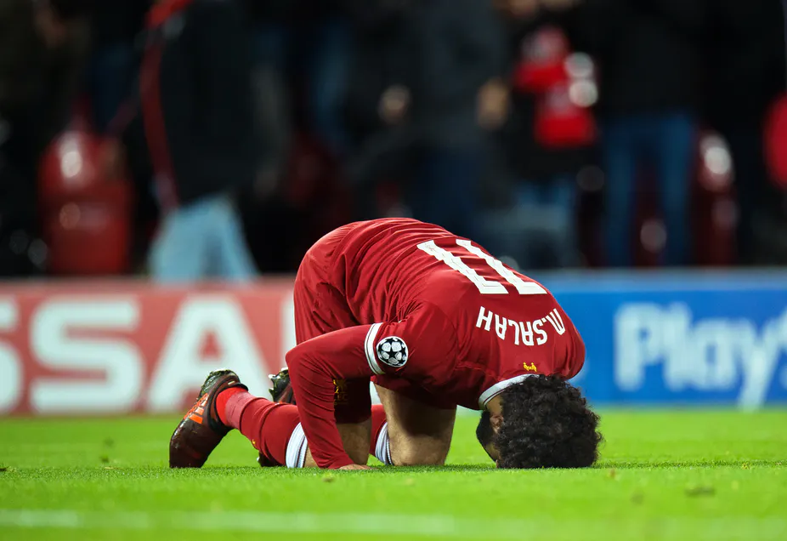
Sajdah
Notes:
Have you ever seen a soccer player performing Sajdah? Why do you think he is performing sajdah?
Performing sajdah is the best way to remove pride from someone especially when they have done something good and feel great about it, as it reminds them that it was only because of Allah that they were able to do that thing in the first place!

Slide 5
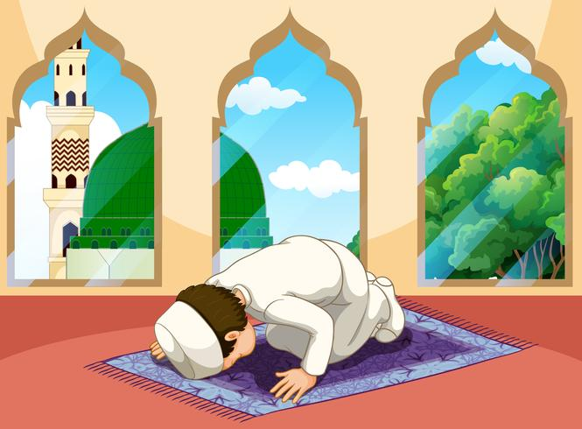
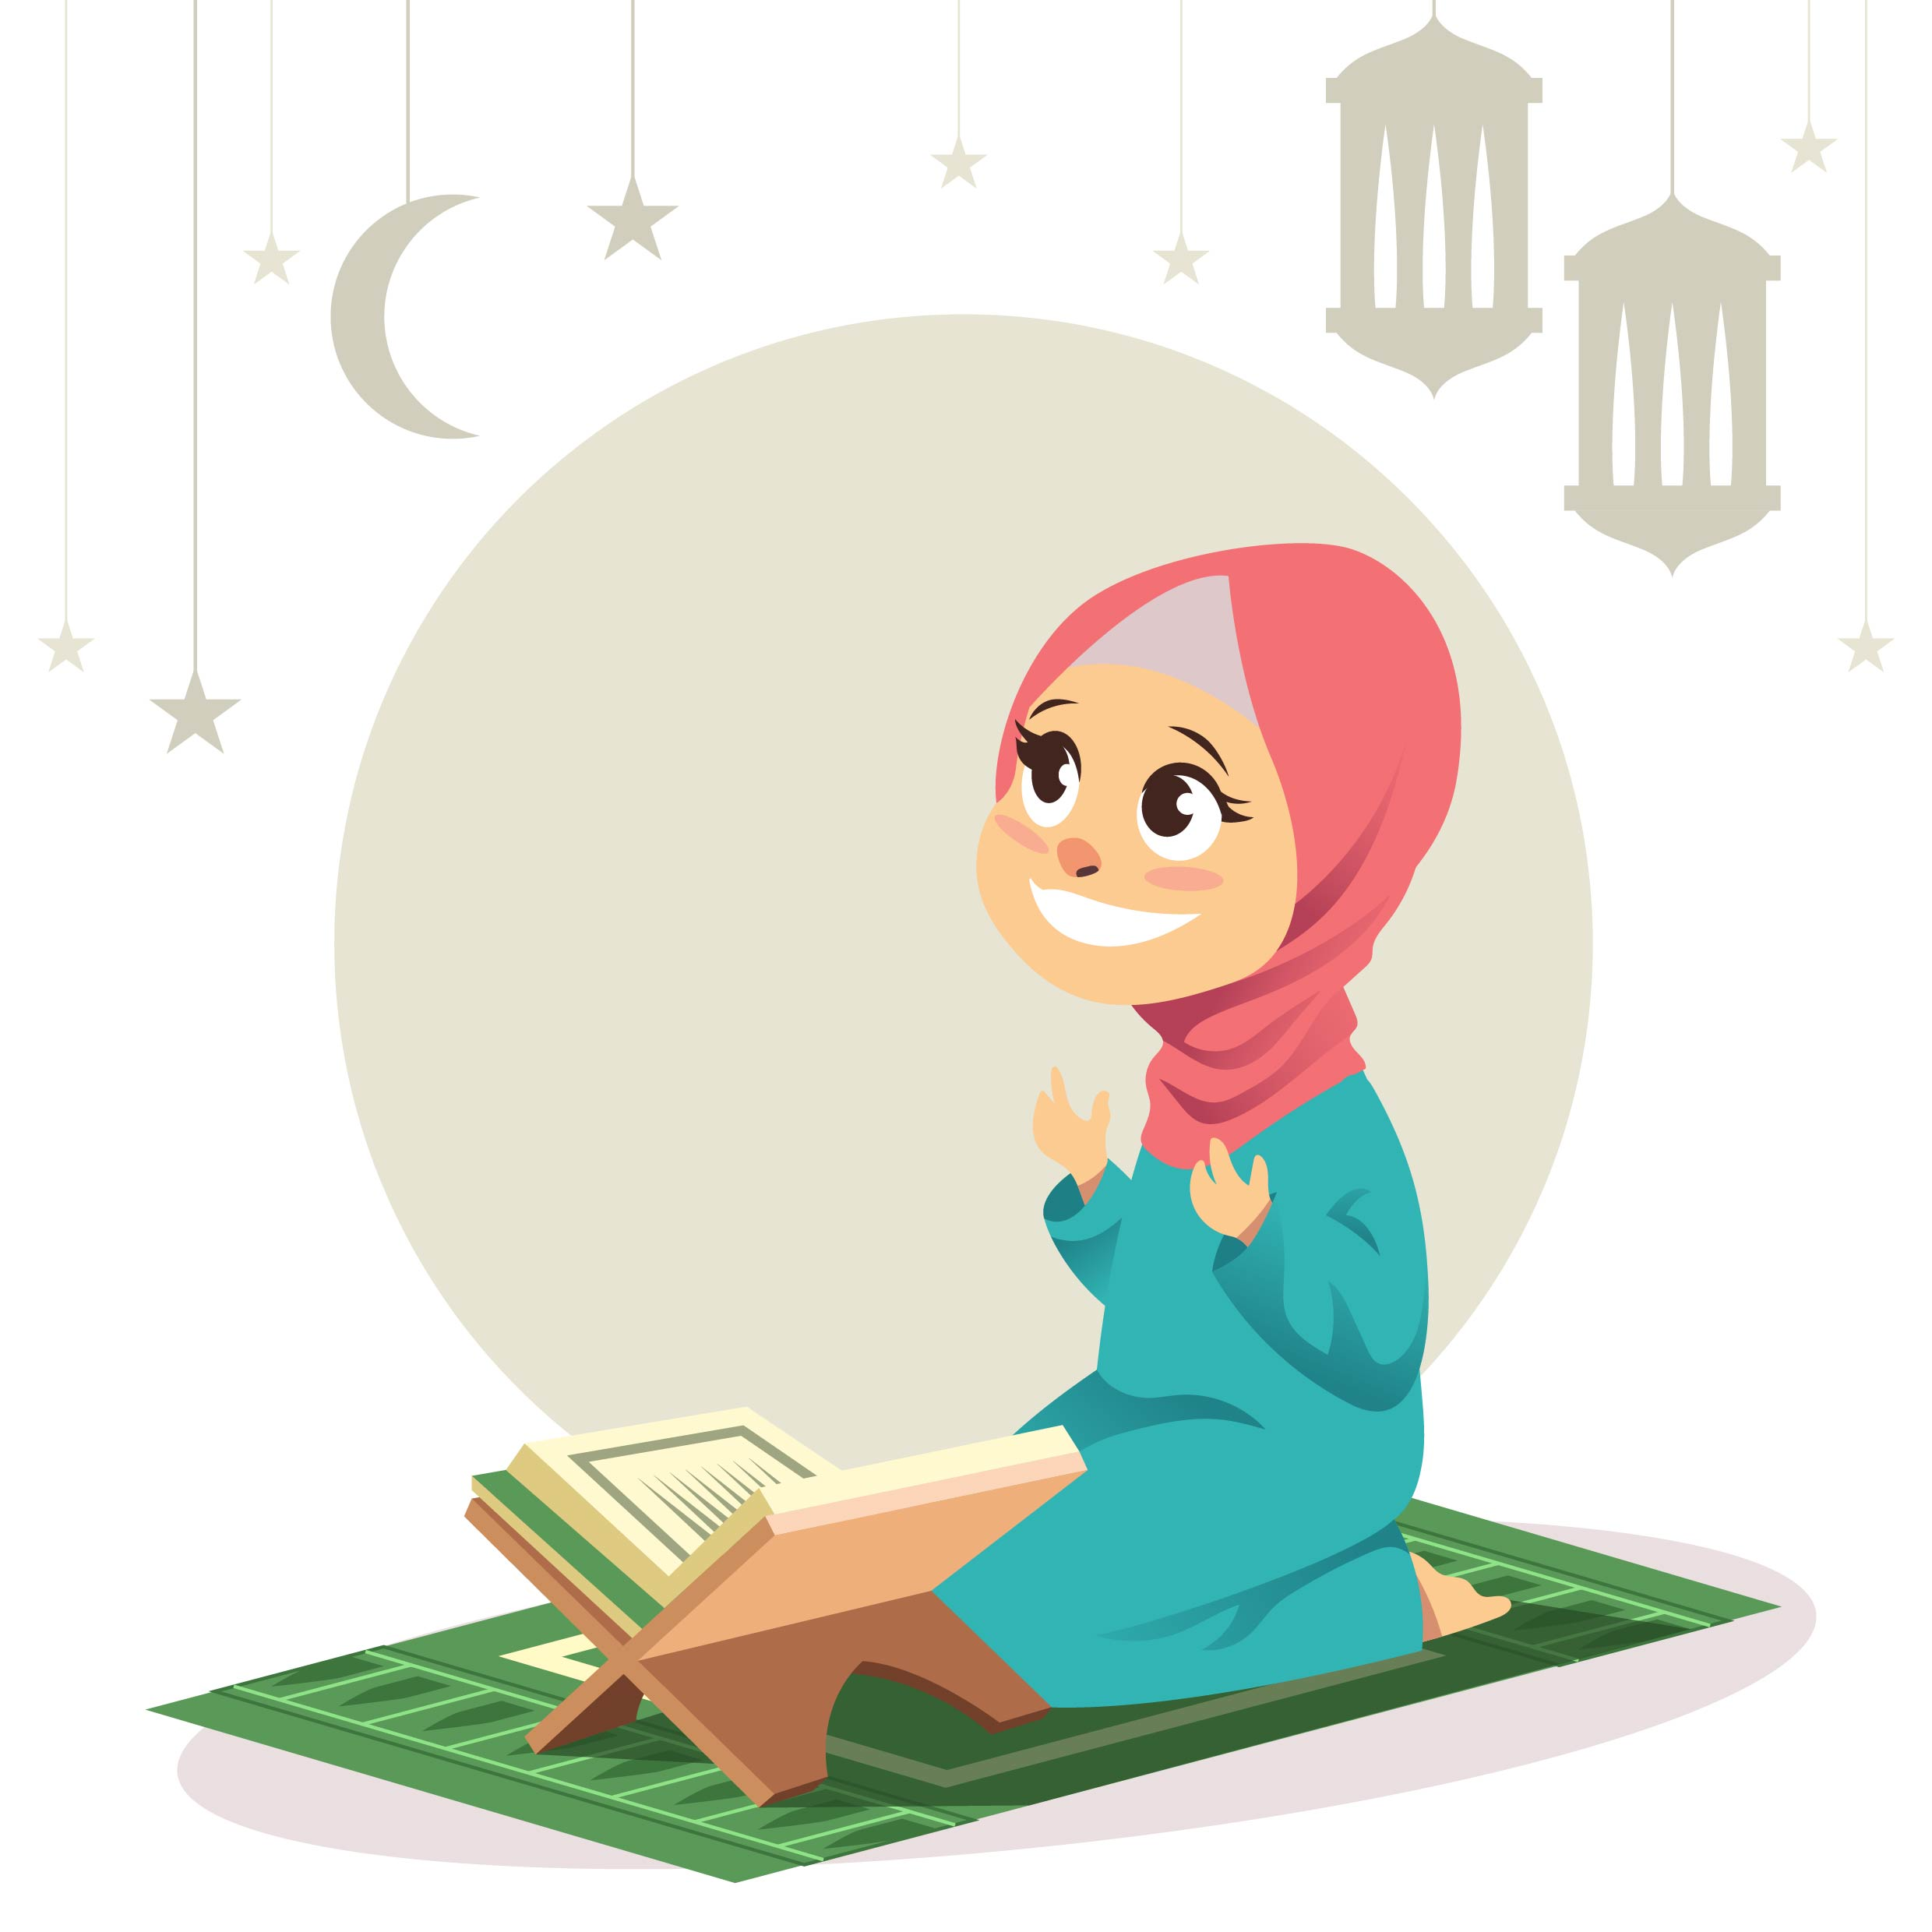
Defences against Shaytan
Shaytan cannot attack us when we are in sajdah and when we have our hands up for du‘a.
Notes:
Shaytan tries to attack us from all sides BUT he CANNOT attack us when:
1. we look up and raise our hands in du‘a because Shaytan can never stop us from doing du‘a.
And
2. When we look down and go into sajdah because he cannot stop our prayers being answered in this position either!
How lucky we are – that even though Allah gave Iblis permission to bother us, He left these two positions open for us to pray to Him! Subhanallah!
Let’s all perform a sajdah of shukr for having been blessed with these defences against Shaytan. Let’s also thank Allah for making sajdah a cure for pride as when we bow down we remember that pride is only for Allah and no one else. Only He is Al-Mutakabbir (The Greatest) – and rightly so!

Slide 6
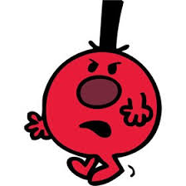
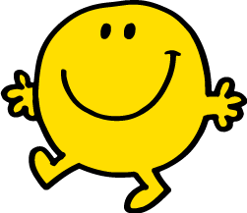
Meet Mr. Proud and Mr. Humble

Slide 7
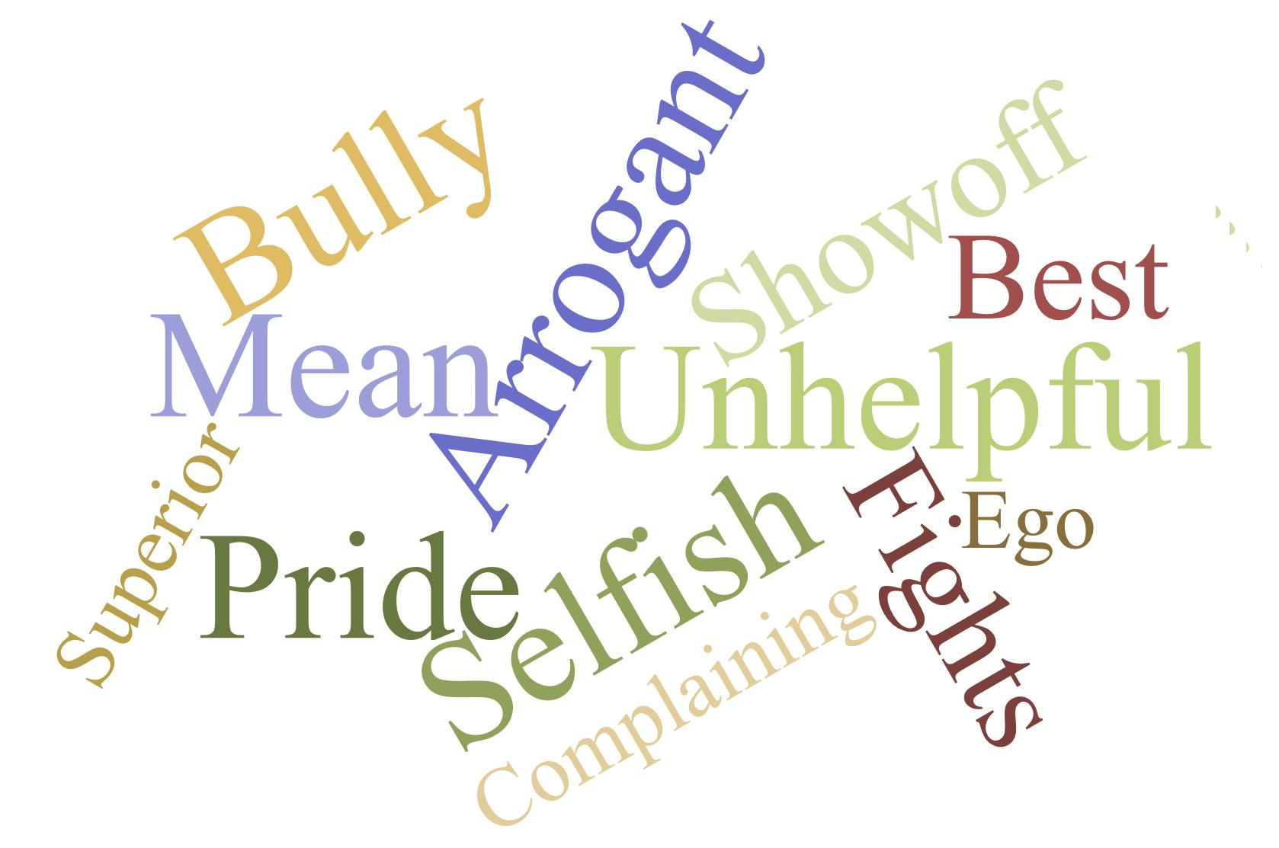
Mr. Proud
Notes:
What do you think Mr. Proud is like? (Discuss and then click to bring up word cloud. Alternatively, can create a word cloud during class with ideas provided by students).
Mr. Proud only likes to look at himself. When he does see other people, hardly ever – but when he does, it’s only to see their mistakes, weaknesses, and failures. He shows off all the time. He’s always telling us about his good grades, his football goals, how he is the most popular student and so on. He complains about other people and talks about them behind their backs. He hates to be told what to do. He doesn’t like to hear that he is wrong about anything, so he starts to fight when someone corrects his mistakes. He is always causing fights because he never gets what he wants. He demands his own way. He thinks he deserves to be served and thinks he is very important.

Slide 8
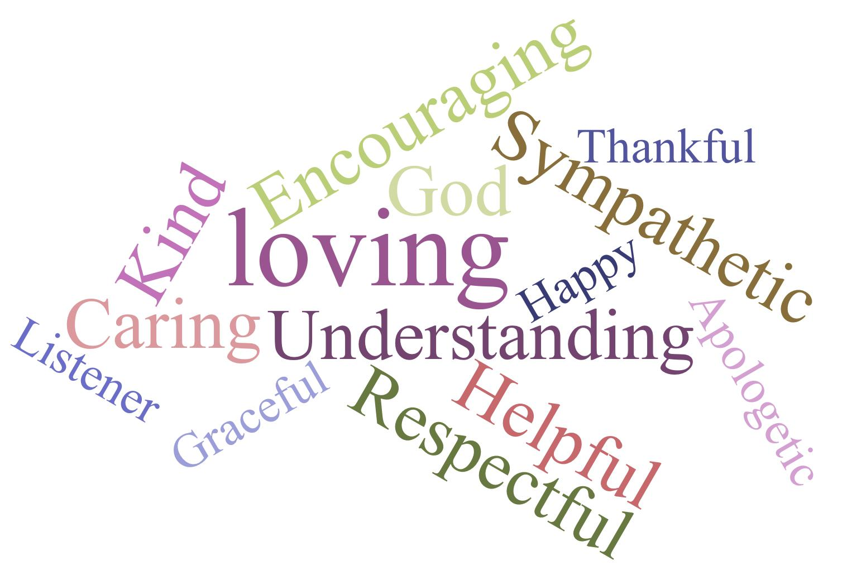
Mr. Humble
Notes:
What do you think Mr. Humble is like? (Discuss and then click to bring up word cloud. Alternatively, can create a word cloud during class with ideas provided by students).
Mr. Humble sees Allah first and then others. He knows that people matter to Allah, so he treats them with respect and is kind towards them. He is often talking about how awesome Allah is. He also likes to say nice things about others and is always happy for them when they do well. He always uses his words to encourage everyone! Realise that sometimes he makes mistakes, so he hears people out and he apologises for his mistakes. He makes people happy. Mr. Humble is always walking softly, towards people who need help and helps without being asked.

Slide 9
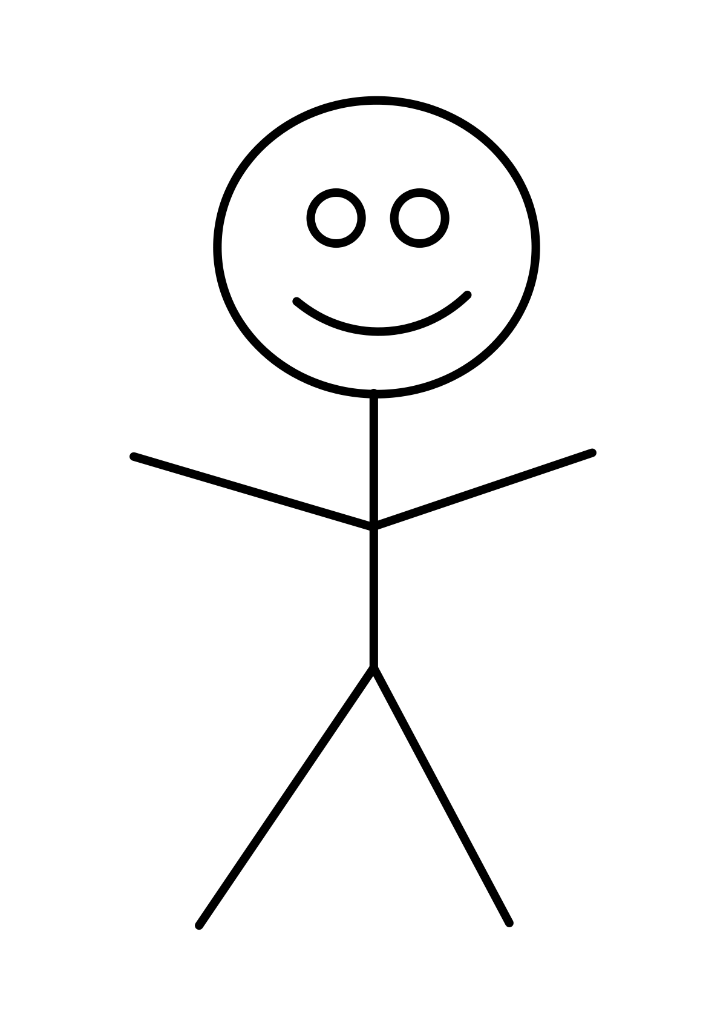
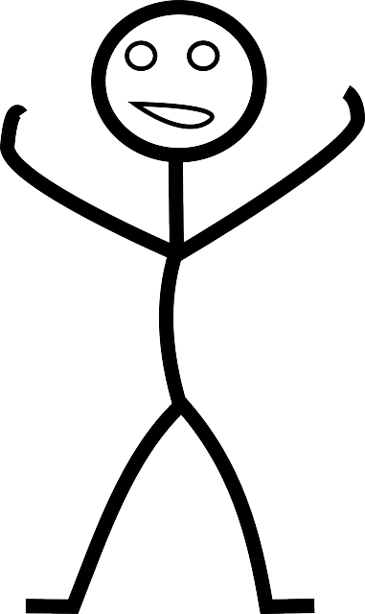
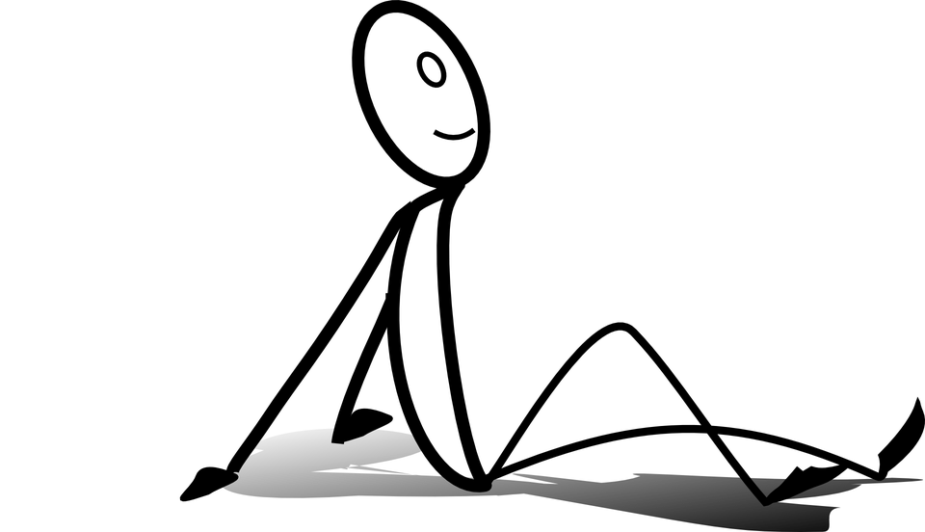
Notes:
(Click once) Do you think that Mr. Proud gets along with anyone?
(Click once) What about Mr. Humble?
What does Allah think of each of them?
(Click once and wait. Discuss while waiting) These are all of their friends, family members, neighbours.
(Click once as above) Mr. Proud does not get along with people. Pride destroys everything – relationships with people around you and even yourself. It ends up all alone.
(Click once) Humility builds more relationships.
Remember that: “Pride comes before a fall” (explain saying). Do you remember who the first creation of Allah was to show pride? And what was his fall? Elicit Iblis.

Slide 10
Notes:
Allah does not like the proud people (read Ayah and meaning).

Slide 11
Learning Summary
Recognise through his story, that Iblis was the first creation to be proud
Justify that pride belongs to Allah alone
Discover that being proud is following in the footsteps of Iblis (Shaytan) and is disliked by Allah

