Slide 1
WUDHU
A‘udhu billahi minash shaytanir rajim Bismillahir rahmanir rahim Allahumma salli ala muhammadin wa ali muhammad

Slide 2
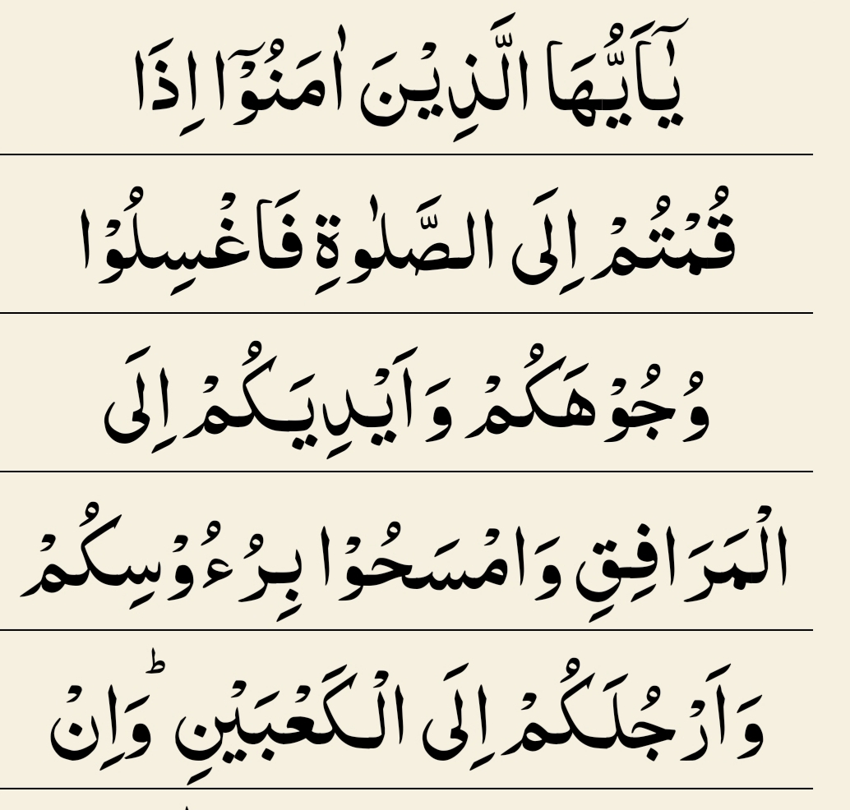

Slide 3
Wudhu in the Qur'an
O you who believe! When you stand for salah, wash your faces and your hands as far as the elbows, and wipe a part of your heads and your feet, up to the ankles
Surah Ma'idah (5:6)

Slide 4
1.WHY DO WE DO WUDHU?
.
2.WHEN DO WE DO WUDHU?
3.HOW MANY OF YOU DO WUDHU IN MOSQUE OR AT HOME?
Notes:
Quizzez Slides – Open ended questions

Slide 5
What do we HAVE to do wudhu for?
WAJIB
MUSTAHABB
Wudhu is a necessity for some actions
Eg: salah
Wudhu is recommended for some actions
Eg: when you are angry
Notes:
Ask them what do we HAVE to do wudhu for?
Explain to them about Wajib and Mustahab

Slide 6
Quiz Time
Notes:
On quizzez

Slide 7
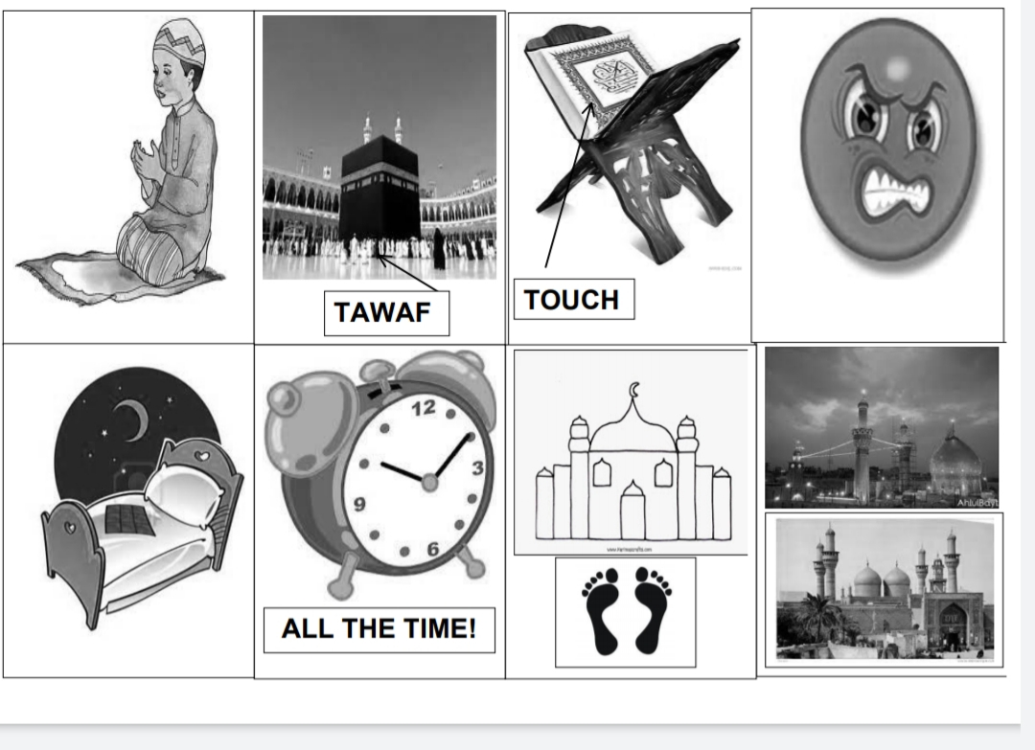
CONTENTS OF THIS TEMPLATE
Here’s what you’ll find in this Slidesgo template:
A slide structure based on a multi-purpose structure, which you can easily adapt to your needs. For more info on how to edit the template, please visit Slidesgo School or read our FAQs.
An assortment of illustrations that are suitable for use in the presentation can be found in the alternative resources slide.
A thanks slide, which you must keep so that proper credits for our design are given.
A resources slide, where you’ll find links to all the elements used in the template.
Instructions for use and final slides with:
The fonts and colors used in the template.
A selection of illustrations. You can also customize and animate them as you wish with the online editor. Visit Stories by Freepik to find more.
More infographic resources, whose size and color can be edited.
Sets of customizable icons of various themes.
You can delete this slide when you’re done editing the presentation.
Notes:
Games on Quizzez

Slide 8
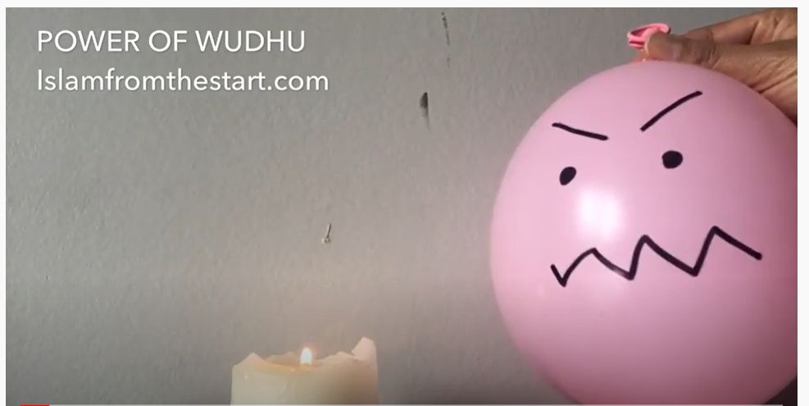
Video Time

Slide 9
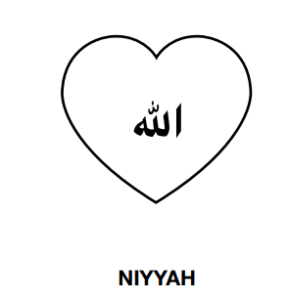
Wudhu Actions
STEP 1
1. Niyyah – WAJIB

Slide 10
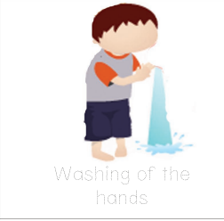
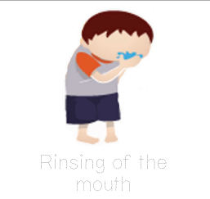
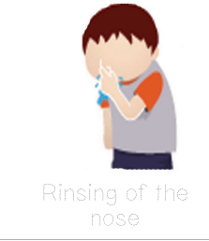
STEP 2 (Mustahabb actions)
1. Washing Hands x2 2. Rinsing the Mouth x3 3.Rinsing the nose x3

Slide 11
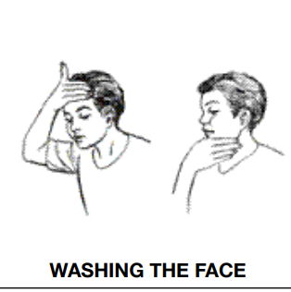
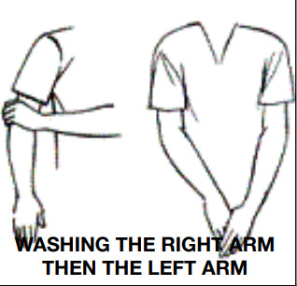
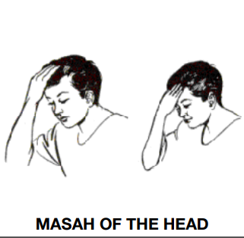
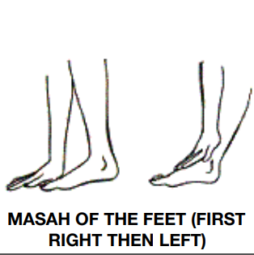
STEP 3 (Wajib actions)
1.Washing the face 2.Washing the arms 3. Masah of the head 3. Masah of the feet

Slide 12
VIDEO TIME!!!
https://youtu.be/EIkjBZUwvKA

Slide 13
STORY TIME!!!!

Slide 14
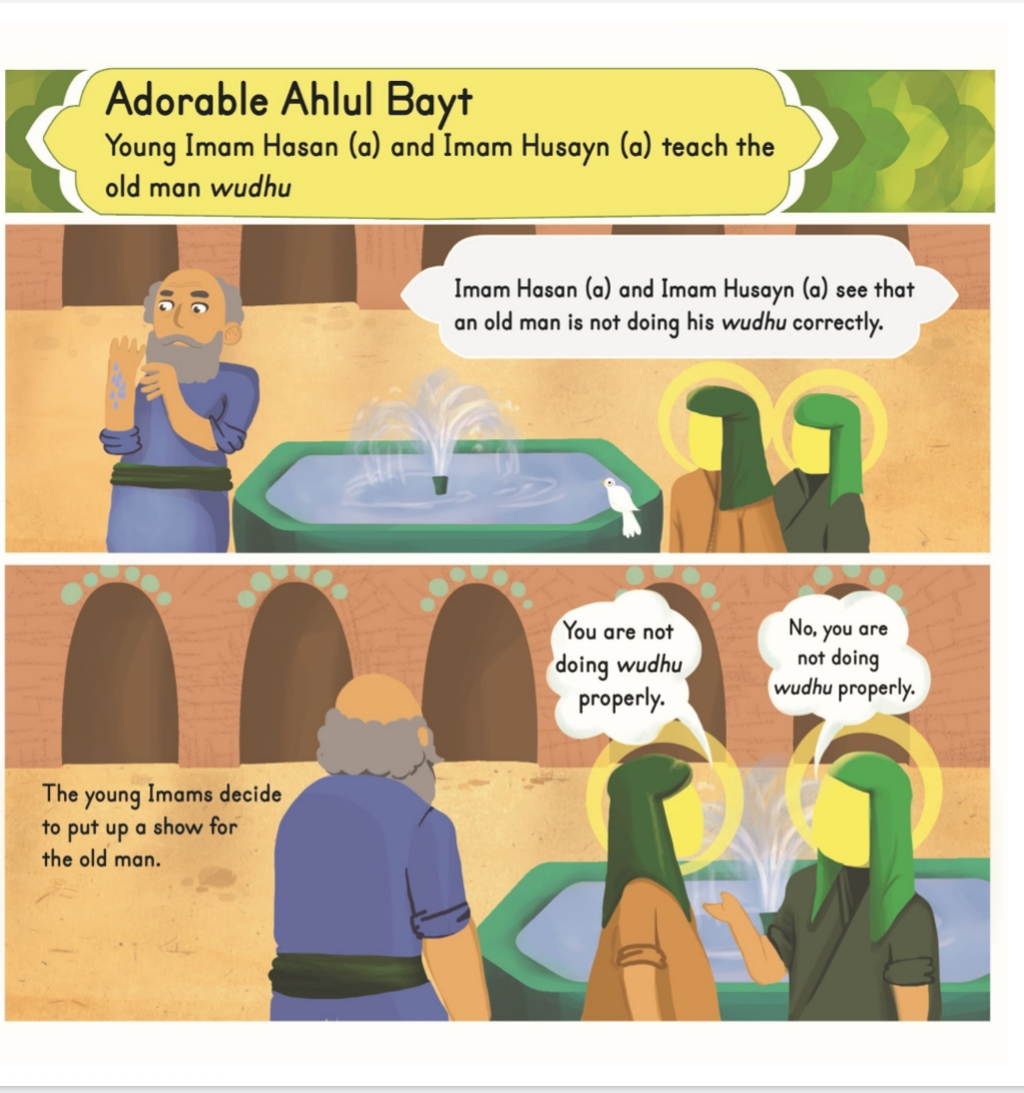
SENTENCES
Write a sentence that includes the following word
Alphabet:
Friends:
Yellow:
Water:

Slide 15
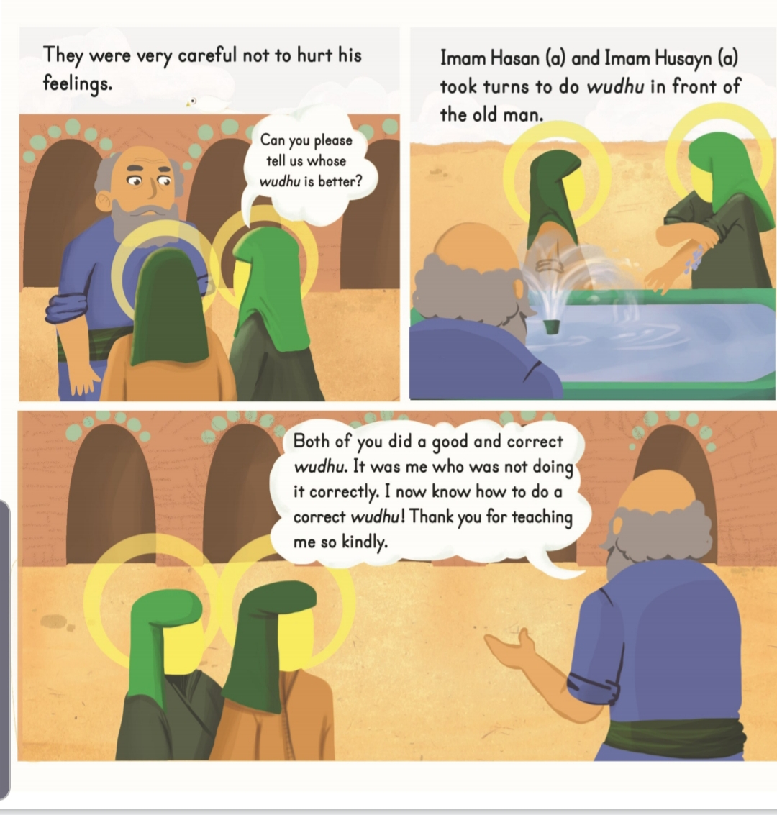
WAJIB
MUSTAHAB
Jupiter is the largest planet in the Solar System
Saturn is composed mostly of hydrogen and helium

Slide 16
THANK YOU FOR WATCHING!

