Slide 1
2A02 - Nubuwwah and
The Mercy of Allah (SWT)
Notes:
Audho billahi...bismillah...welcome back everyone! Does anyone remember what we talked about last week? Give them hints...: ‘Who always knows what is good for us and what is bad for us?’ ‘Allah!’
Say: ‘Yes exactly! Allah is al-Aleem. He knows everything.
Last week in class, we also discovered that Allah is not even a tiny bit unfair to anyone. Recap some of the silly examples from last week, then ask, ‘does Allah know what is best for us?’ Isn’t that awesome?!!!
Please make sure you see lots of nodding ;)

Slide 2
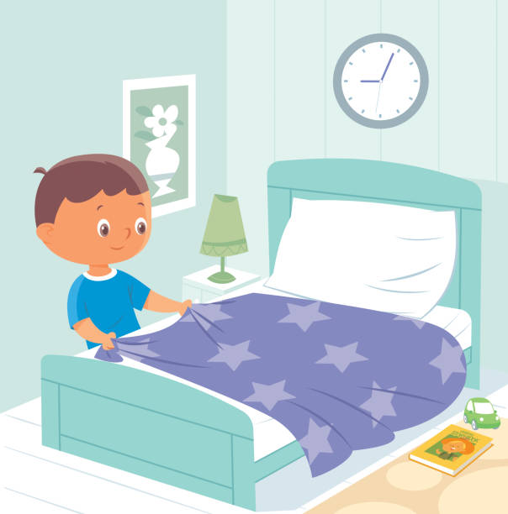
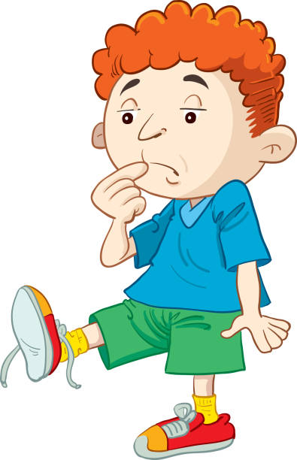
Notes:
Now ask your students how many of them think that they can do everything right without someone helping them or showing them how?
Do you know how to make your own bed? Did anyone show you how to do it? Do you know how to wear your own snow pants? Or put BOTH your gloves on? How about a super duper tricky one...how many of you know how to tie your own shoelaces?
Have props in front of you, and struggle with your zip. Or be silly with your gloves...the goal is to show that we need a GUIDE to do things correctly!
Things like how to dress properly, how to pray salah correctly, how to behave well with others, and how to be a good person.’ The students should answer: ‘Yes.’
‘Do you all remember that Allah created everything?’ TG 1A01: Allahu khaliqu kulli shay (allow students to recall by saying each word slowly to prompt them).

Slide 3
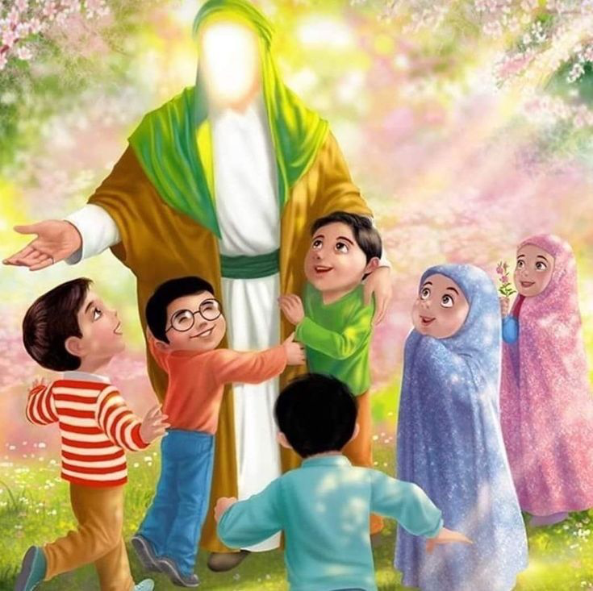
Who has been sent to guide us?
- 124,000 Prophets
- 12 Imams
Can we name some of them?
Who sent them?
Notes:
‘Allah made everything and if He had just left us,, would we know what to do with our lives?’
‘Allah is very kind. He is ar-Rahman – even kinder than our … mummies!
‘Would He create us and then leave us without someone to guide us?’ The children will reply: ‘No!’
nform your class: ‘Allah, in His kindness, sent us many, many guides. They are known as anbiya. They came to this world at different times, to guide the people. The Qur’an is full of their interesting stories.’ Ask the kids who has been sent to guide us? Try and have them name specifics such as Prophet Muhammad (SAW) Imam Ali (AS) and Imam Hussein (AS).
Discuss with the kids who is guiding us now. Briefly discuss Imam Mahdi (AS) and who we go to if we have a question - Mujtahids.

Slide 4
“Allah sent ambiya to give (us) good news and to warn (us)”
— Surah Al-Baqarah, 2:213
فَبَعَثَ اللّٰهُ النَّبِيِّيْنَ مُبَشِّرِيۡنَ وَمُنۡذِرِيۡنَ
Notes:
Read the Ayaat slowly to the kids a few times and then have them read it with you. Read the translation and ask them:
What kinds of good news would they give us? A: Allah has created Jannah in the hereafter for his believers.
What kinds of things would they warn us about? A: Story of Prophet Nuh and the flood.

Slide 5
Nubuwwah
Notes:
Ask the kids to say the word with you. Briefly talk about Usul-e-Deen and see if they can list some of them. Introduce Nubuwwah as a concept and describe it - messengers of Allah (SWT)
Remind kids about some Prophets and their stories briefly.

Slide 6
Story Time!
“Manarah the Lighthouse”
Notes:
Read the story book titled, “Manarah - The Lighthouse 2A02”

Slide 7
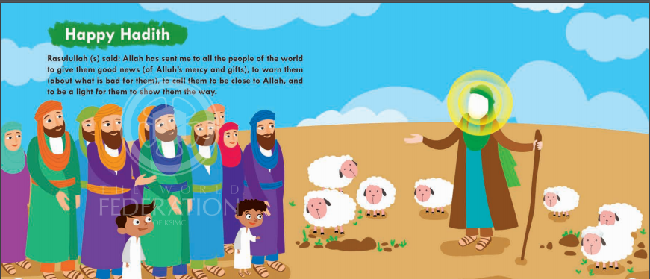
The lighthouse’s Guidance
Notes:
AFTER THE STORY: Ask the kids, “How is a lighthouse like the Prophet? What does the lighthouse do that the Prophets also do?”
Allah loves those who listen to His guides, the anbiya, and do all the right things in their lives.’

