Slide 1
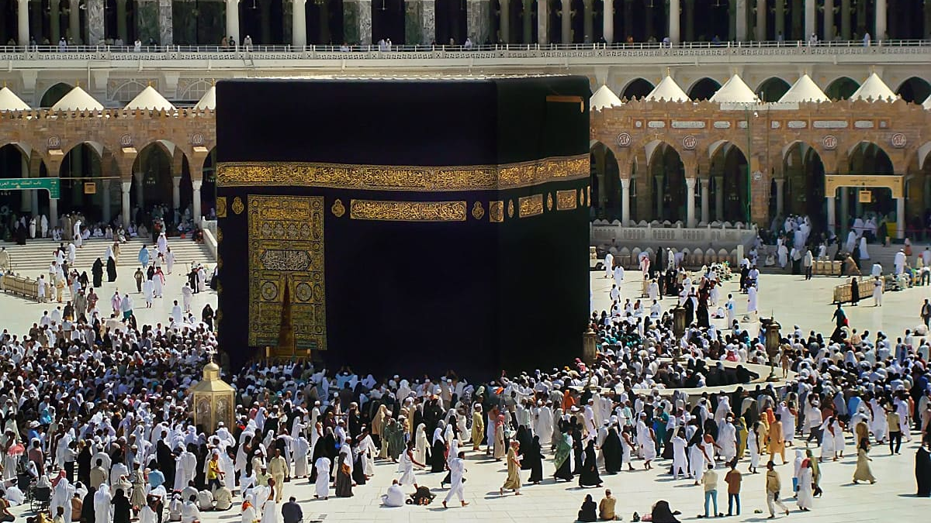
Nabi Ibrahim and The Ka’bah
Tarbiyah: 2A04
Notes:
Instructions on how to conduct this lesson:
Recap of previous lesson
Ayah of the lesson
Story
Some questions to ask the students
CRAFTTTTT !! Please note craft will take 30 mins so please try to finish the part before in 20mins so you can focus on the craft.

Slide 2
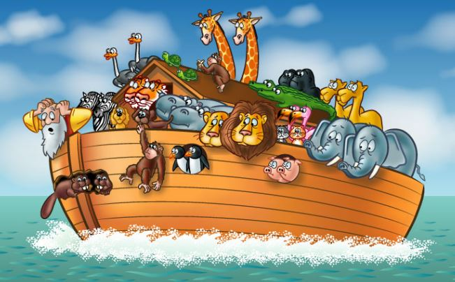
Notes:
Talk about previous lesson on Prophet Nuh – Ask the following questions:
Can anyone recall how the Quran describes P. Nuh? - hint: Innahu …
Answer: Innahu kaana abdan shakoora – Nabi Nuh was a very thankful Nabi
2. ‘In the story of Nabi Nuh, the people who did not agree to believe in Allah and board the ark, were drowned. Was this unfair of Allah?’
3. ‘How do we know that this is the right answer? Does an ayah in the Qur’an tell us about Allah’s fairness?’
4. 2A01: innallaha la yadhlimu mithqala dharratin: Allah is not even the tiniest bit unfair to anyone! Conclude the recap by saying: ‘It was because the people did not listen to Allah’s message that they drowned.’

Slide 3
ذَٰلِكَ وَمَن يُعَظِّمْ شَعَـٰٓئِرَ ٱللَّهِ فَإِنَّهَا مِن تَقْوَى ٱلْقُلُوبِ
Explanation: The people who give importance to the signs of Allah do so because they care from deep in their hearts
Surah Hajj:32

Slide 4
Notes:
https://madrasahonline.org/lessons/2a04-nabi-ibrahim-and-the-kabah/

Slide 5
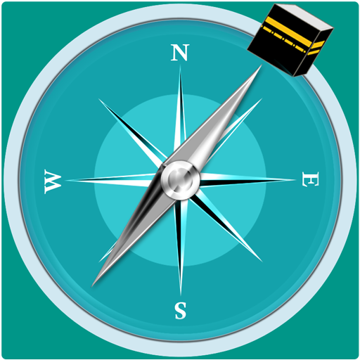
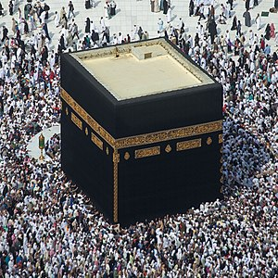
Allah Is Everywhere!
Turn left or turn right.. Allah is …
Notes:
Some questions to ask after reading the story!
Which special house did we read about? Kids will answer – Kaaba?
Does Allah live inside this house? They will reply – NO – That’s right – Allah does not live inside any house. Spread your arms and say ‘Allah is Everywhere’
What is the name of the house? Answer – KAABA
‘If Allah doesn’t live inside the Ka‘bah then why does He call it His house?’ – clue: facing in the direction of the Ka‘bah to pray.
Conclude: ‘Allah has chosen the Ka‘bah as the direction that all Muslims face when they pray. This house is a sign that reminds people of Allah and that is why it is called Allah’s house. The Ka‘bah also brings Muslims together from all over the world when they go to visit it.’

Slide 6
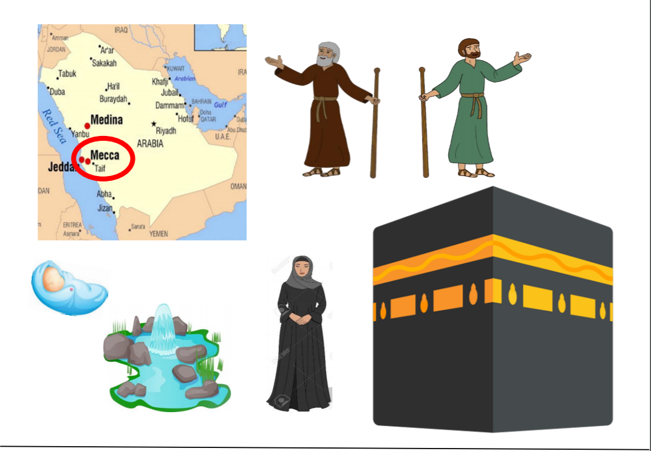
Let’s reconstruct the story!!
Notes:
For the craft: Please send the PDF file to parents before time so they can cut and keep it ready for the day.
https://madrasahonline.org/wp-content/uploads/2019/01/2A04_LO2_story-collage-cut-outs.pdf
Things required:
Print out 1 Background https://madrasahonline.org/wp-content/uploads/2019/01/2A04_LO2_story-collage-background.pdf - Blank paper can be used if students haven’t printed this out
Print out 2 https://madrasahonline.org/wp-content/uploads/2019/01/2A04_LO2_story-collage-cut-outs.pdf
Glue
For broom you can either do it as instructed in Teacher’s guide or print out a broom picture.
Rhyme (if you want) - https://madrasahonline.org/resource/2a04-lo2-rhyme-3/
Instructions on how to make the craft – You can follow LO2 activity on Teacher’s guide for detailed explanation for MODULE 2A04.
Brief instructions:
Pin your already made collage background to the screen your students will be able to see it clearly. You can find already done collage here: https://madrasahonline.org/wp-content/uploads/2019/01/2A04_LO2_collage-layout-sample.pdf
Start by asking if they have blank papers, cut-outs, and glue sticks.
‘What did Allah ask Nabi Ibrahim to do with his wife Hajar and little son Isma‘il?’ Answer - : ‘To leave them alone in the desert.’ Ask: ‘Did Nabi Ibrahim obey Allah?’ Wait for a resounding ‘Yes!’
Instruct your students to glue the cut-out of Lady Hajar and Baby Isma‘il between the mountains. Glue your cut-outs on your own paper at the same time.
‘When all their water had ran out and Baby Isma‘il became very thirsty, what did Lady Hajar do?’ Wait for the answer: ‘She ran between mountains to find water.’ Ask: ‘Did she find water?’ The students will respond: ‘No!’ Say: ‘Nabi Ibrahim obeyed Allah and left his family in the dry and hot desert without any water. What did Allah do? Did He leave them thirsty?’ The answer should come in the form of the appearance of Zam Zam
glue the cut-out of Zam Zam near Baby Isma‘il and as you do so explain that Allah rewarded Nabi Ibrahim for his obedience, and the spring of Zam Zam did not only quench the thirst of Baby Isma‘il and Lady Hajar, it also quenches the thirst of everyone who goes to the Ka‘bah!
Which city the Ka‘bah is in? It is situated in the holy city of Mecca.
Instruct your students to glue the map of Mecca in the top right corner of their A4 sheet and you should do the same
‘When Baby Isma‘il became a young man, Allah asked Nabi Ibrahim to build the Ka‘bah in Mecca. Did Nabi Ibrahim obey Allah?’ ‘Yes!’
‘Take the Ka‘bah and glue it on to the left side of the mountains.’ As the students glue the Ka‘bah ask: ‘Would you build a big and beautiful house in a place where there is nothing nearby? No shops, no roads, and no people?’ Most students will say: ‘No!’ Now ask: ‘Why did Nabi Ibrahim build the Ka‘bah when there was nothing around?’ Allow the students to think and offer their answers. Discuss what they say and then point out that Allah knows best what is good for us and what is bad for us (ref: lesson 2A01). Explain that Nabi Ibrahim knew that Allah knows best so he obeyed Allah without question.
Hand out the mini brooms and continue the story: ‘When the Ka‘bah was ready, Nabi Ibrahim and young Isma‘il cleaned the Ka‘bah from inside and out. They knew that the Ka‘bah is a sign of Allah and looking after the signs of Allah is very important. Let’s clean the Ka‘bah like they did.’ Allow students to use their mini brooms to sweep over their collages. As they sweep, say: ‘Allah tells us in the Qur’an: wa mayn yu‘adhdhim – sha‘a’ir allahi – fa innaha min – taqwal qulub. This means that the people who give importance to the signs of Allah, do so because in their hearts.’ Now ask emphatically: ‘Do you care about the Ka‘bah and all the other signs of Allah from deep in your hearts?’ Wait for your students to answer: ‘Yes!’ Then say: ‘So then lets sweep and repeat the ayah together: wa mayn yu‘adhdhim – sha‘a’ir allahi – fa innaha min – taqwal qulub.’ Sweep your own Ka‘bah as you repeat the ayah with your students. Now glue Young Isma‘il near the Ka‘bah and glue the mini broom to his hand. Instruct your students to do the same. Moving back to the story, say: ‘When Nabi Ibrahim and Nabi Isma‘il were done cleaning the Ka‘bah, Allah ordered Nabi Ibrahim to call people to come the Ka‘bah to worship Allah. Did Nabi Ibrahim obey Allah?’ Wait for a resounding ‘Yes!’ Then glue Nabi Ibrahim on to the roof of the Ka‘bah and ask your students to do the same.
‘Did people come to the Ka‘bah from all over the world to worship Allah?’ Wait for your students to respond: ‘Yes!’ Explain that, throughout the story, Nabi Ibrahim’s obedience to Allah resulted in big rewards that last till today! Not only did people come to the Ka‘bah when Nabi Ibrahim called them, they continue to come to the Ka‘bah even today! HOMEWORK: Last part as homework and tell them to use diff colour paints and dip their thumb and make thumb prints all around the Kaaba, all the way to the edge of the page to show that people from all over the world come to the Ka‘bah to worship Allah in response to the call of Nabi Ibrahim.

Slide 7
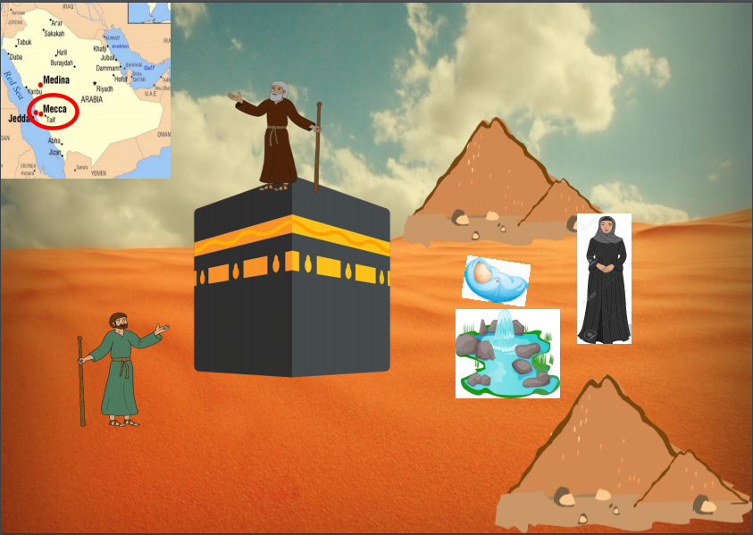
Notes:
Keep this as your screen once you start the craft! So its easy for the kids to follow instructions.

Slide 8
Lesson Summary
To identify why the Ka‘bah is called the house of Allah.
To derive lessons from Nabi Ibrahim’s obedience to Allah.
To demonstrate how one may honour the places where Allah is remembered.

