Slide 1
Nabi Musa’s Birth and Childhood
Storybook: Allah’s Promise
Tarbiyah 2A05
Notes:
Salaamun Alaykum class. Hope you are all doing well! Today we are going to learn about the birth and childhood of a very special prophet of Allah.

Slide 2
Notes:
Does anyone know where they were born?
Many years ago a Prophet was born whose birth was an amazing and not an ordinary event. This Prophet was Prophet Musa! Does everyone know Prophet Musa?
I am going to tell you the story of his birth and in this story there are many times that Allah protects Prophet Musa. When I tell you the story whenever you feel Allah is protecting Prophet Musa you can wave at me! So are you ready?
And when I tell you the story there are a few actions we will do together so listen carefully for the instructions!

Slide 3
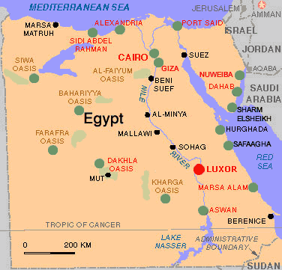
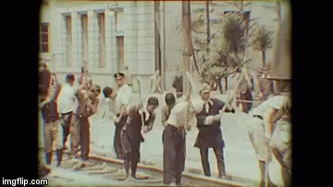
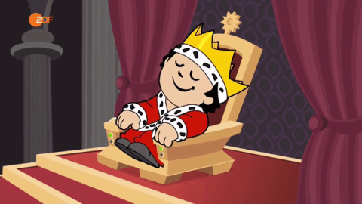
Notes:
A long time ago, in a land known as Egypt, lived a King. His name was Fir‘aun. The people living in that land were known as the Bani Isra’il and were made to work for King Fir‘aun (everyone stands up and works – digging action). He was mean and proud. (Make an impression with hands on hips pointing to yourself in pride) He made everyone work so hard in the hot sun (everyone continues working – wipe sweat). He treated everyone very badly. He even called himself God. (gasp!)

Slide 4
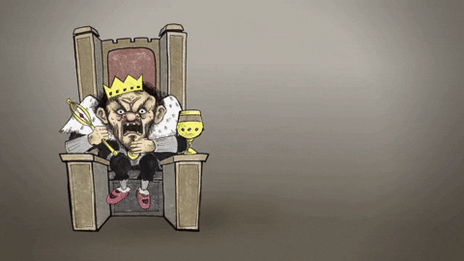
Notes:
One day, one of his men came to him. He said that he had a dream and saw King Fir‘aun taken over by a man who would be born in his land. This made King Fir‘aun very nervous and angry. (looking angry). ‘How dare anyone take over my position as King!’ he thought to himself. He was furious. He told his soldiers to take all the baby boys away from their mummies.

Slide 5
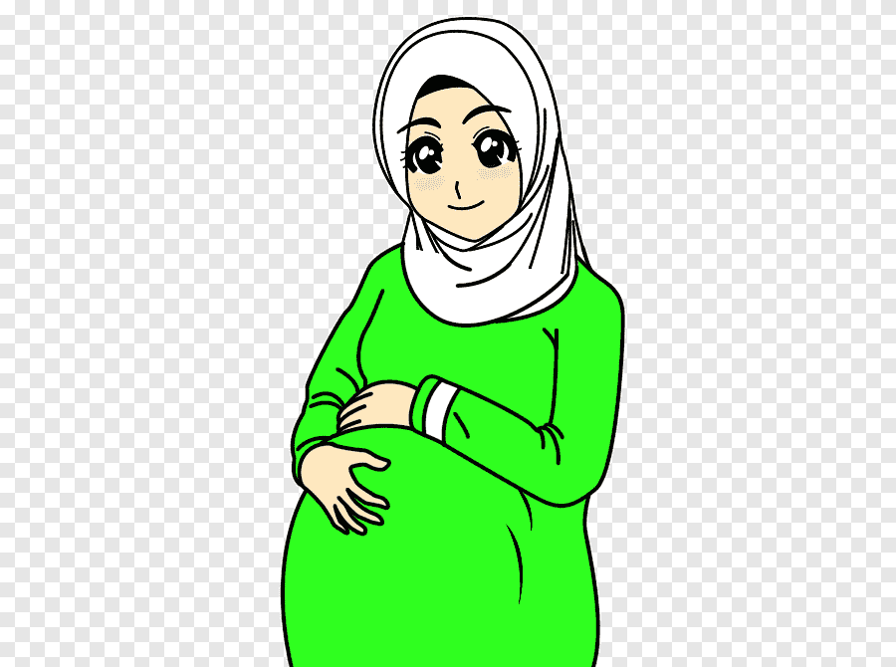
Notes:
In the meantime, in a little house at the bottom of the River Nile lived a lady. Her name was Yukabid. She was very kind and gentle. She loved Allah and believed in Him. She had a secret. Can anyone guess what it is? The secret is in her tummy! That’s right, she had a baby inside her tummy!

Slide 6
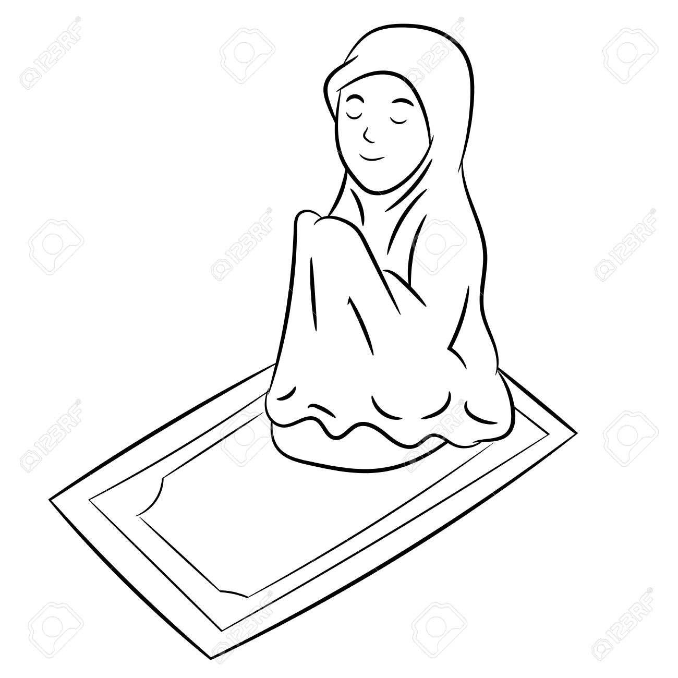
Notes:
But her tummy wasn’t big and round. It didn’t look like there was a baby in there. Yukabid knew that King Fir‘aun was taking all the baby boys away from their mummies. She didn’t want King Fir‘aun to take her baby away. Allah protected her baby by keeping the baby a secret. Allah made her tummy tiny. (Remind the kids about smiling)

Slide 7
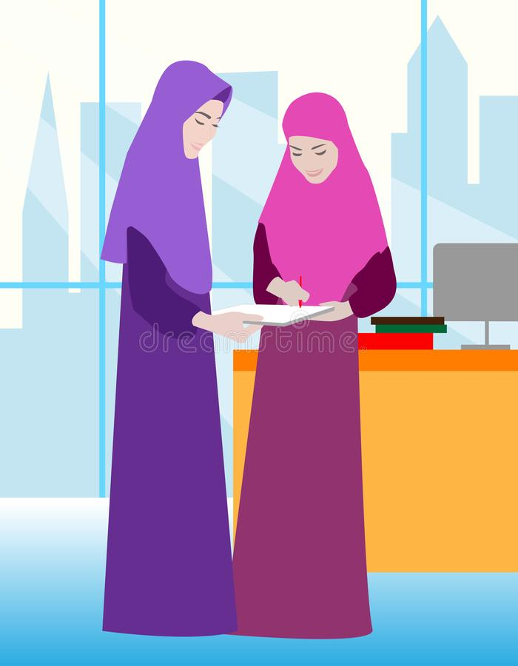
Notes:
Yukabid had a kind friend who helped take the baby out of her tummy. She had a baby boy called Musa! The soldiers of Fir‘aun were busy looking out for any baby boys (soldiers march). But Yukabid and her friend kept baby Musa a secret. Shhhhhh. (Ask children to put finger on their lips and say shhh).

Slide 8
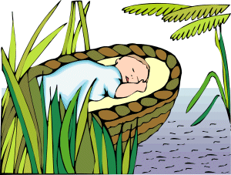
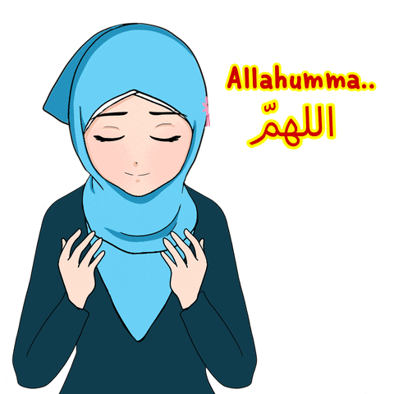
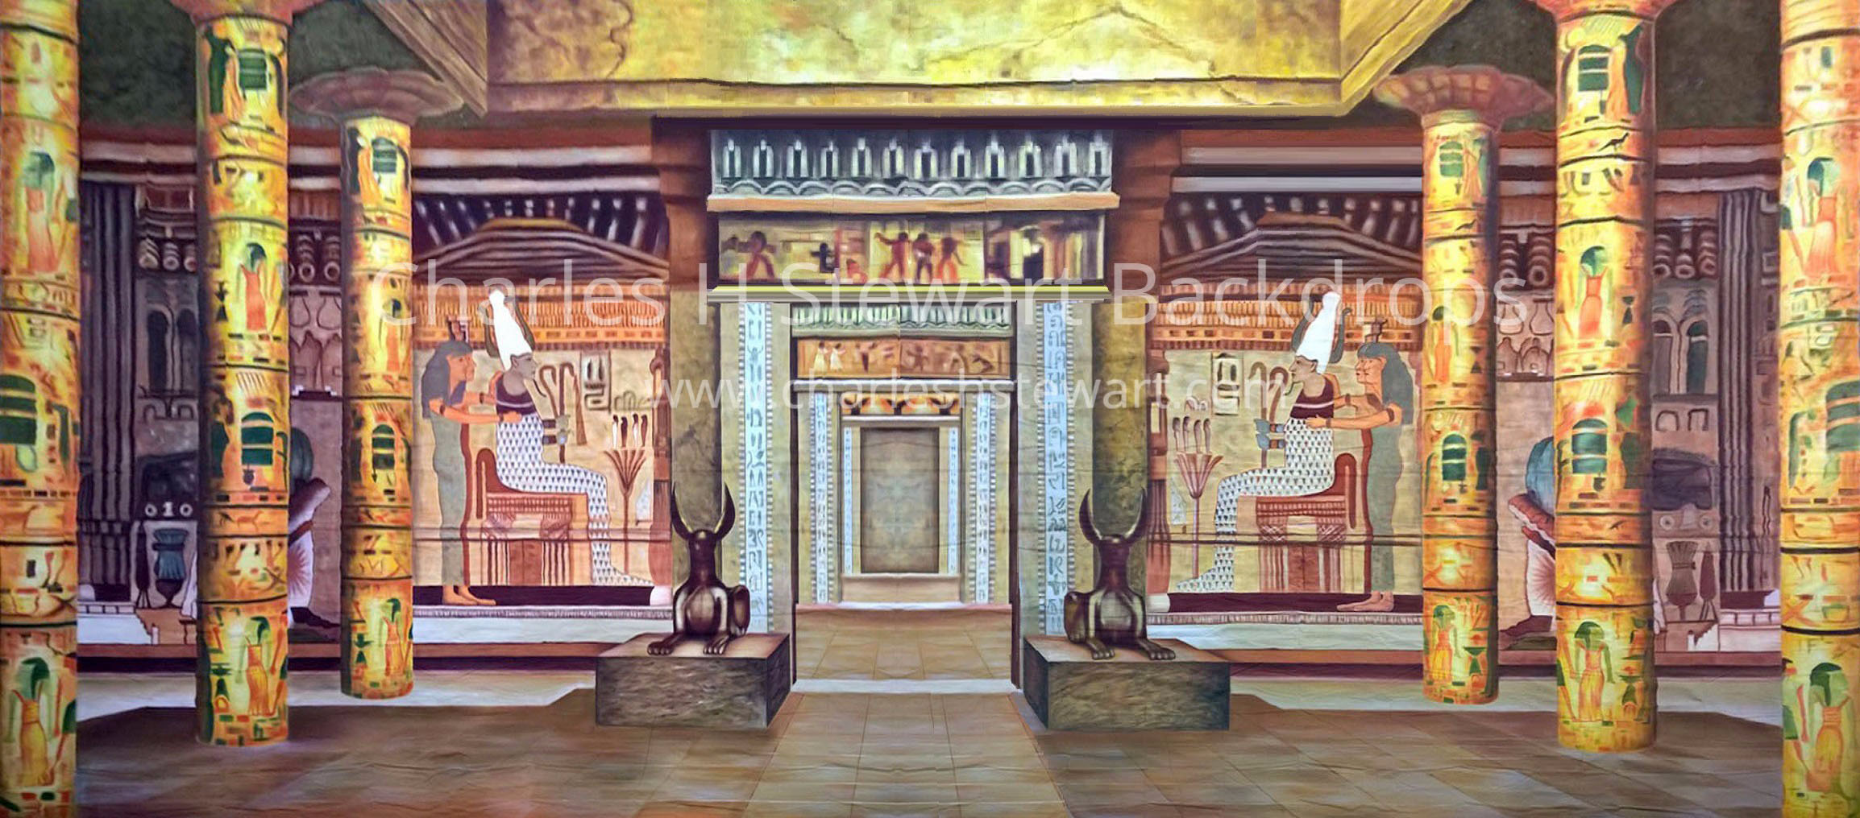
Notes:
Yukabid was afraid and in huzn or sadness that King Fir‘aun would find out about her baby so she prayed to Allah. (Ask the children to raise their hands in du’a) Allah gave her a special idea to put the baby in a basket and place the basket into the River Nile.
Allah told her not to worry and not be sad and promised that she would be united with the baby again. (Remind kids to smile). This was Allah’s WA’D or promise. She packed Baby Musa in a basket, all nice and warm. Then she put him in the River Nile. Musa’s sister watched the basket go bobbing down the river. The basket sailed all the way to Fir‘aun’s palace.

Slide 9
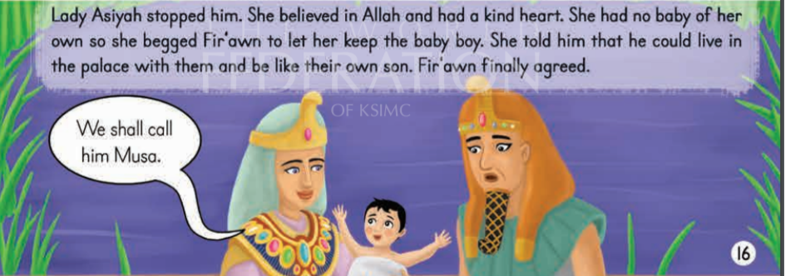
Notes:
King Fir‘aun’s wife was called Sayyida Aasiya and she found the basket in the river. She was a wonderful gentle lady, unlike Fir‘aun. She didn’t have any children. When she saw the baby she was so happy! She begged Fir‘aun to let her keep the baby and told him he would be a delight for their hearts and a joy to their eyes. King Fir‘aun was not so sure as he wanted to get rid of all the baby boys.

Slide 10
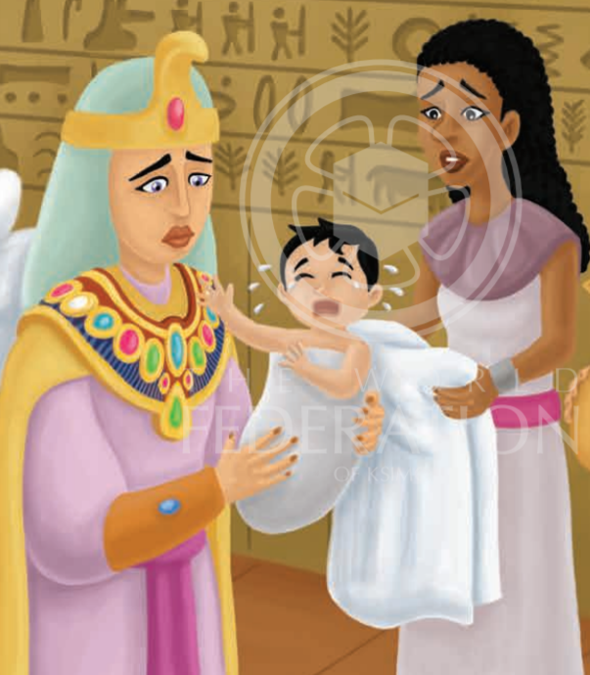
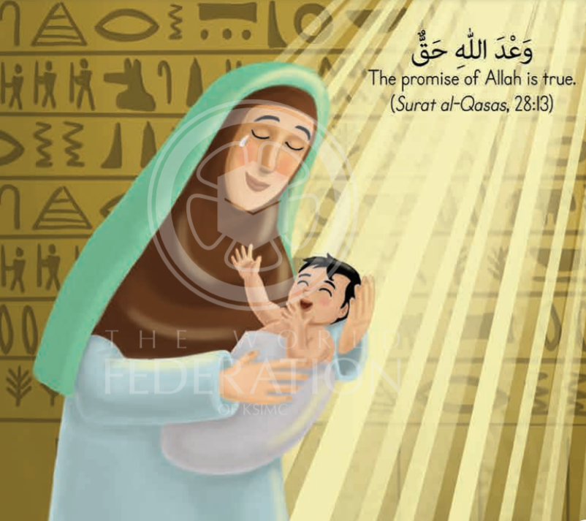
Notes:
Finally, he agreed! (Remind about smiling) but Baby Musa would not stop crying. He cried and cried. (Ask children to make crying sound). Queen Aasiya tried to quieten him down, but he just would not stop crying. Musa’s sister saw all this and asked Queen Aasiya if she would like someone to help look after the baby. Queen Aasiya nodded her head, trying so hard to calm Baby Musa. Musa’s sister brought Baby Musa’s mummy to the palace. As soon as Baby Musa’s mummy carried Baby Musa, he stopped crying! (Remind kids to smile). The promise of Allah was true and baby Musa was back in his mummy’s arms once again!” (Ask children to pretend as if they are holding a baby.)

Slide 11
Notes:
Does anyone remember what Allah promised Prophet Musa’s mum when asking her to put Prophet Musa in a basket? Remind about promise.
And Allah kept his promise! In the Quran Allah swt says : Arabic + English. And this means that Allah always keeps his promise.

Slide 12
Al Hafidh
The Protector
Notes:
There are 4 pictures on the screen – who can tell me what they are?
Now who can tell me what all these things do that are common?...All these things protect us. A bandaid when we get hurt, umbrella from the rain, jackets from the cold, helmet when we are playing games.
And just like Allah protected Prophet Musa, he protects us too!
One of his names is Al-Hafidh – The Protector. He protects us in so many ways, especially by giving us the ability to make and create all these items in front of us, for our protection. Sometimes we know He is protecting us and at other times we don’t know. But He watches over us and protects us at all times!

Slide 13
What I learnt today?
Nabi Musa was born in difficult times
Allah protected him throughout his birth and childhood
Allah protects us at all times

