Slide 1
Nabi Isa and Lady Maryam
Tarbiyah 2A06
Notes:
Salaamun Alaykum everyone. I hope you’re all doing well….

Slide 2
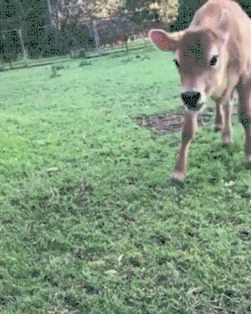
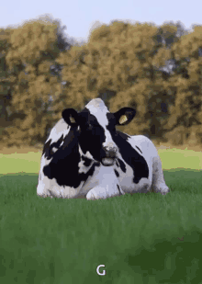
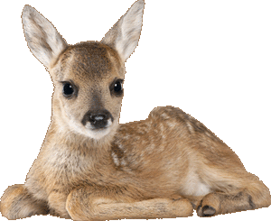
CALF
FOAL
COW
Notes:
Let’s start our class today with an exercise of recognizing mummy and their kids. The first one is the cow. What is a cows child? A calf or a foal?

Slide 3
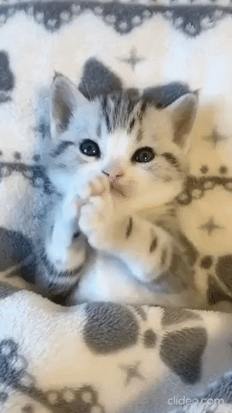
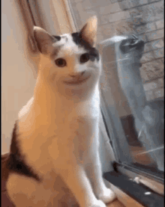
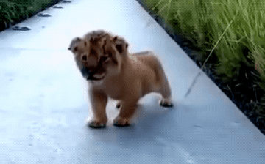
KITTEN
CUB
CAT
Notes:
Who knows what a cat’s baby is?

Slide 4
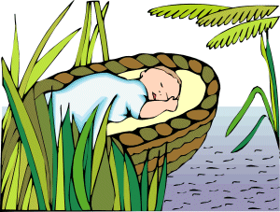
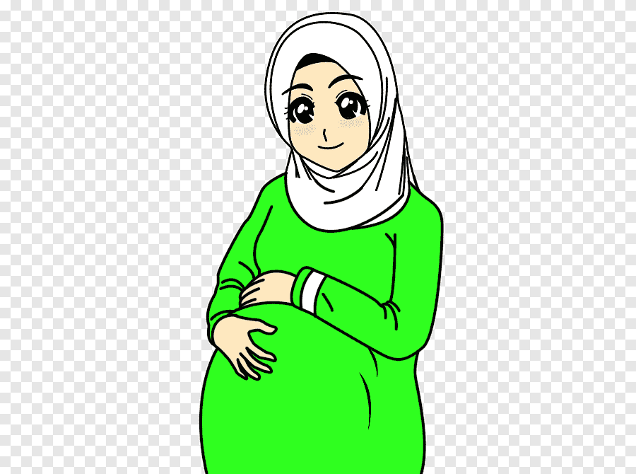
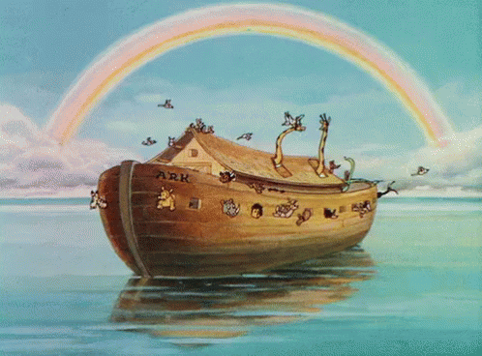
Nabi Isa
Nabi Nuh
YUKABID
Notes:
Now let’s go to some personalities that we know. This first one should be easy since we learnt about it last week!

Slide 5
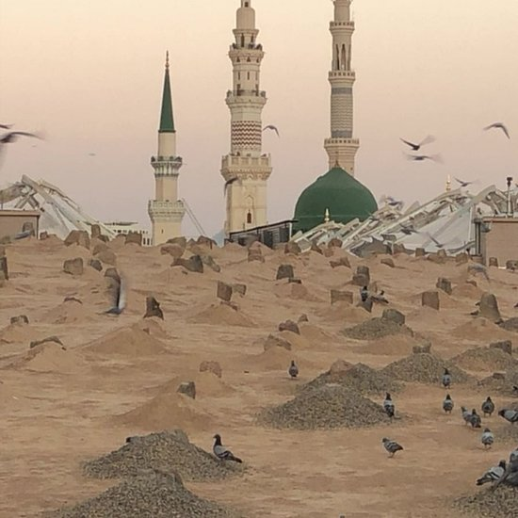
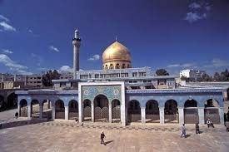
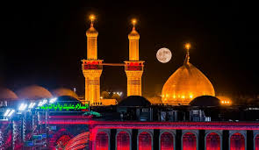
Sayyidah Sakinah (a)
Imam Husayn (a)
Sayyidah Fatimah (a)
Notes:
How about this one? Who knows who was Bibi Fatema’s child? Was it Bibi Sakina or Imam Husayn?

Slide 6
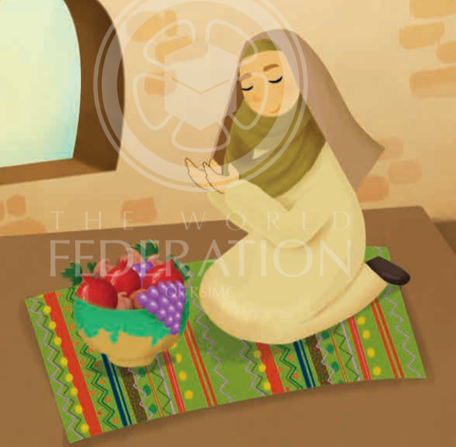
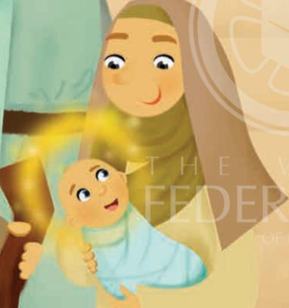
Nabi Isa
Lady Maryam
Notes:
Now, the reason we discussed mummy and kids was because today we are going to learn about Bibi Maryam and her son. Does anyone know who her son was? Hint: He is a prophet!
It’s Prophet Isa!

Slide 7
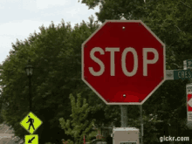
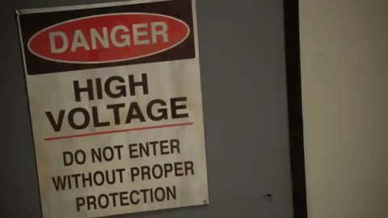
Notes:
What do you all see on the screen? Name each.. Stop sign, danger sign, no smoking, no phones, traffic lights
Each sign gives us an important message! Discuss each briefly
the Arabic word for sign is ‘ayah or ayat’! Where have they heard that before? Yes! The Qur’an is made up of ayahs. They are all signs pointing us towards Allah’s Greatness. Tell them that they will be hearing the story of Nabi Isa and after listening to the story they have to tell you what sign of Allah can be seen in this story. (Answer given at the end: One of the signs of Allah was when Nabi Isa talked as a baby.)

Slide 8
Notes:
Are we ready for the story?
Teachers: PLEASE start the story by reading the bubble in the pic above

Slide 9
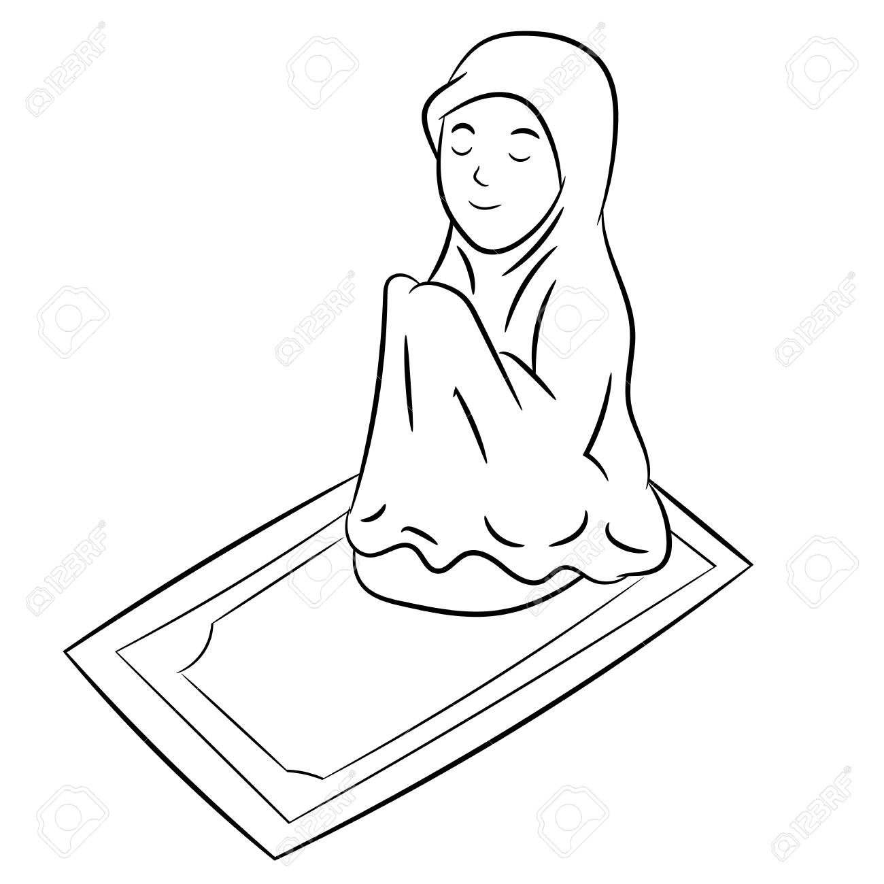
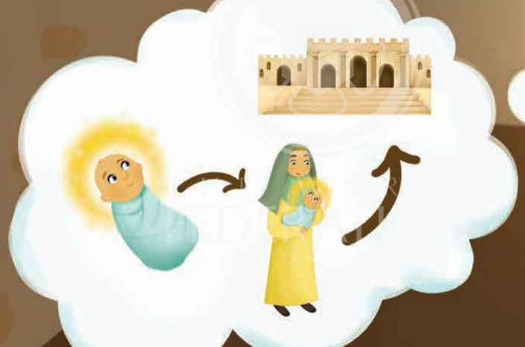
Notes:
“A long time ago, there was a lady called Hannah, and her husband was called Imran. They did not have any children. Hannah prayed to Allah (ask the kids to do dua hands) and Allah gave her a baby girl! (kids cradle your arms as if you are holding a small baby). They named her Maryam. Because Hannah was so thankful to Allah for this gift, she told Allah that she would gift her daughter to the ma‘bad - the place of worship.

Slide 10
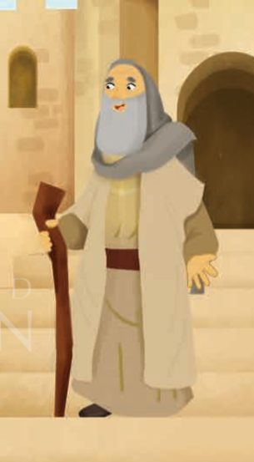
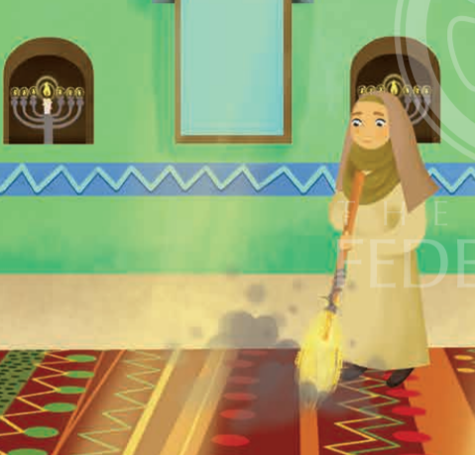
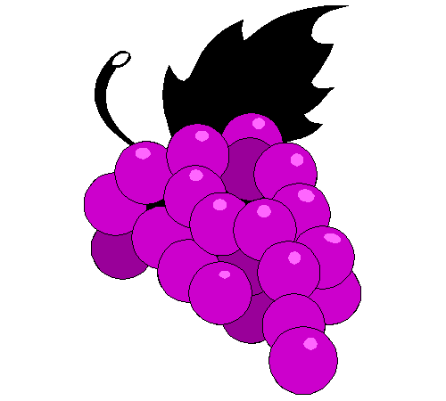
Notes:
When Sayyidah Maryam was a little older, her mother took her to the ma‘bad where she asked Nabi Zakariya (another Prophet of Allah) to look after her. He did so and she grew up worshipping Allah whilst working hard in the ma‘bad (everyone, standup and pretend to use a broom to clean all around you).
One day, Nabi Zakariya visited Sayyidah Maryam in her room. She had such lovely food in front of her. Nabi Zakariya asked “Where does this food come from?” Sayyidah Maryam replied, “From Allah, Allah gives to everyone who He wants”. (Teacher gasps, ooh and ahh over the food from Allah)

Slide 11
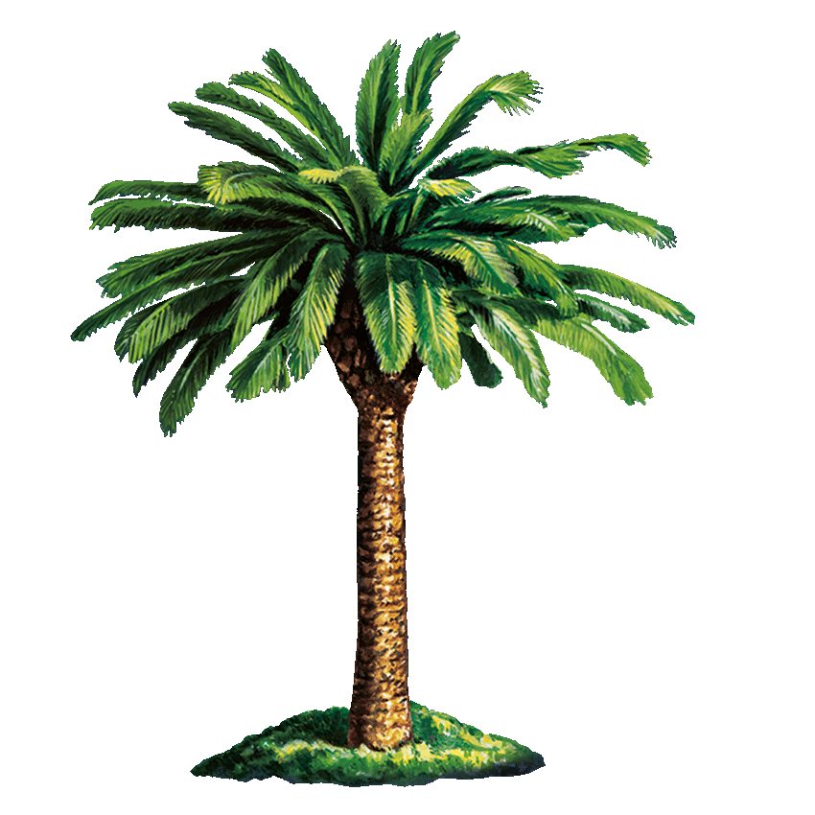
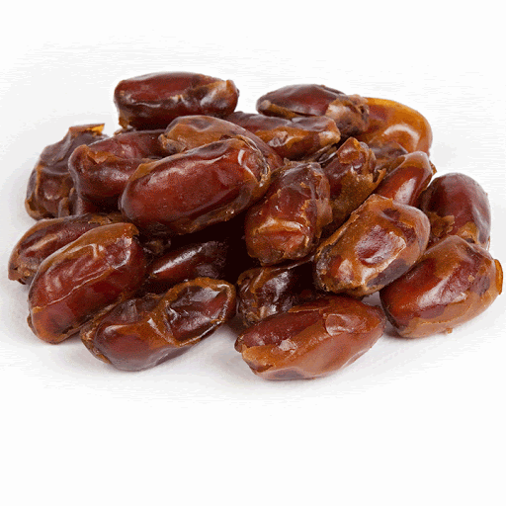
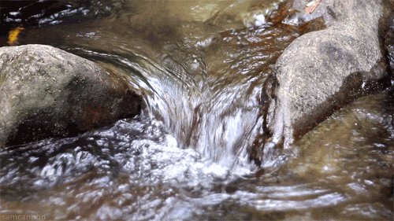
Notes:
Sayyidah Maryam grew up. Allah told her she would soon have a baby. Allah guided her to go towards a palm tree in the desert. There Sayyidah Maryam has her baby boy. She shook the palm tree and dates fell for her to eat. A beautiful stream flowed nearby her feet. Sayyidah Maryam could drink from the beautiful stream. (If you have dates at home, please pretend to share and eat them with your class; you can also take a sip of cool water)

Slide 12
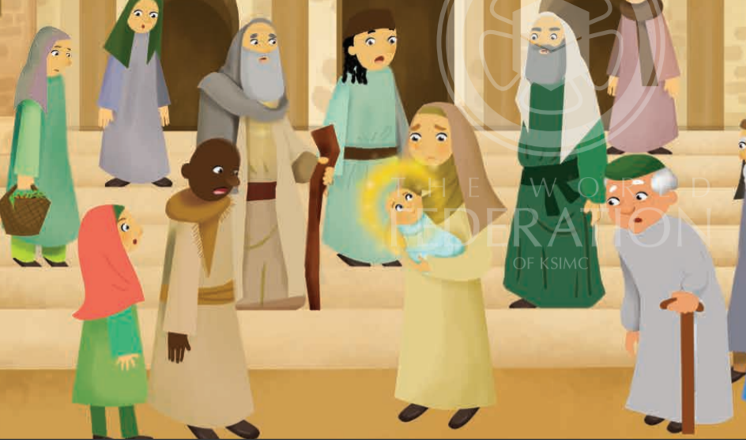
Notes:
Sayyidah Maryam then returned back to the place she was living. The people saw Sayyidah Maryam. They also saw the beautiful baby. Allah asked Sayyidah Maryam to point to the baby. When she did, the baby spoke! He said: “I am Allah’s servant. He has made me a prophet. He has made me loving to my mummy, Sayyidah Maryam.” The people were amazed at the talking baby! The baby was Nabi Isa. He showed that Allah can do whatever He wants and that him talking was a sign of Allah!”
Ask them to tell you what the sign of Allah was. Ask the children if they remember what age they were when they first spoke a sentence. When Nabi Isa talked as a new baby, it was a sign for all the people around him from Allah. Allah can make anything happen!

Slide 13
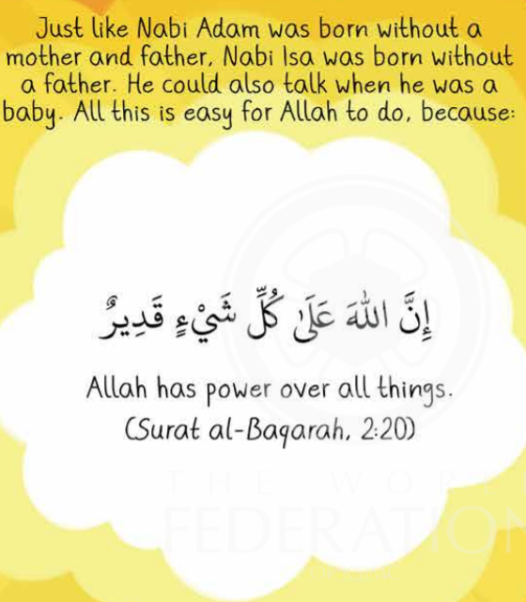
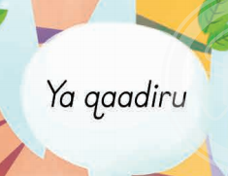
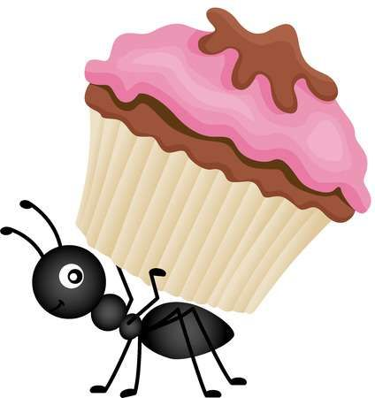
Notes:
Allah can do anything He wants just, like he made Prophet Isa talk when he was just a new born baby! Things that seem impossible He can make happen! That is because one of Allah’s special names is Al-Qaadir – The All Powerful
Repeat the ayah 2-3 times. Saying it slowly, asking the kids to repeat. You can also then say it in a loud voice, and then a whisper…

Slide 14
What I learnt today?
Identify that Nabi Isa was the son of Lady Maryam
Recognise that Nabi Isa is a sign of Allah
Conclude that Allah can do anything He wills

