Slide 1
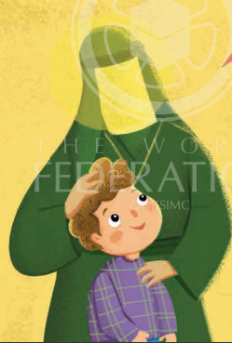
Slide 1
Tarbiyah 3A02
Storybook – Dino’s Adventure
Uswatun Hasanah
A Beautiful Example

Slide 2
Let’s Play a game
Be KIND
BE RESPECTFUL

Slide 3
Which one of these animals is really fast?

Slide 4
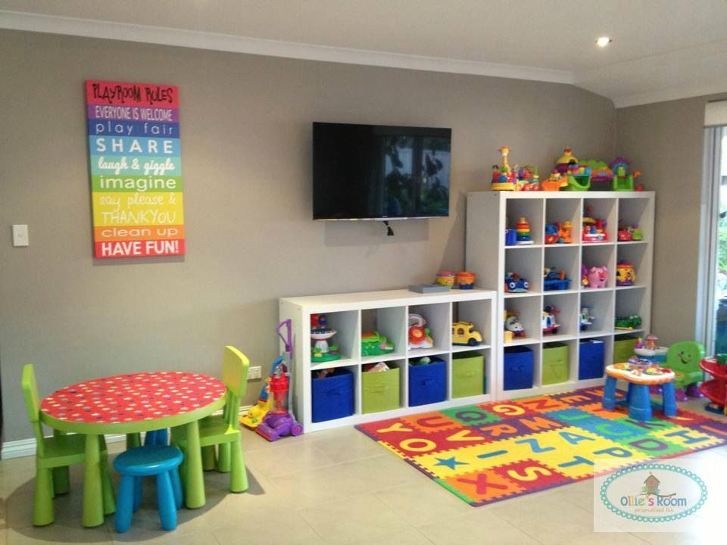
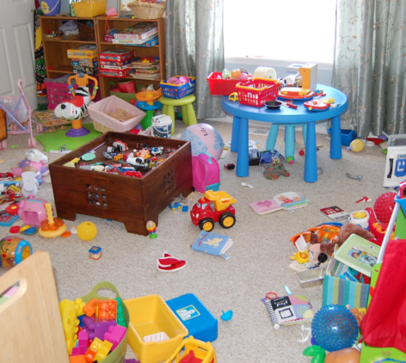
Which of these rooms Looks nicer?

Slide 5
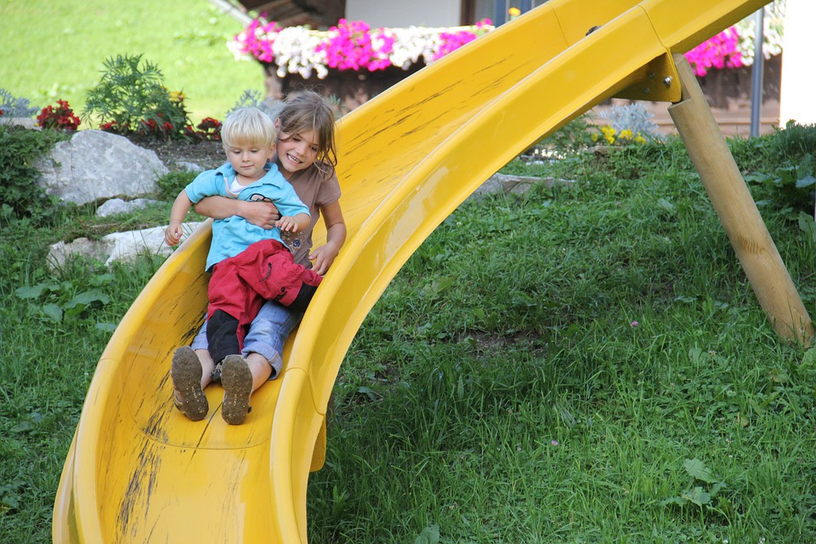
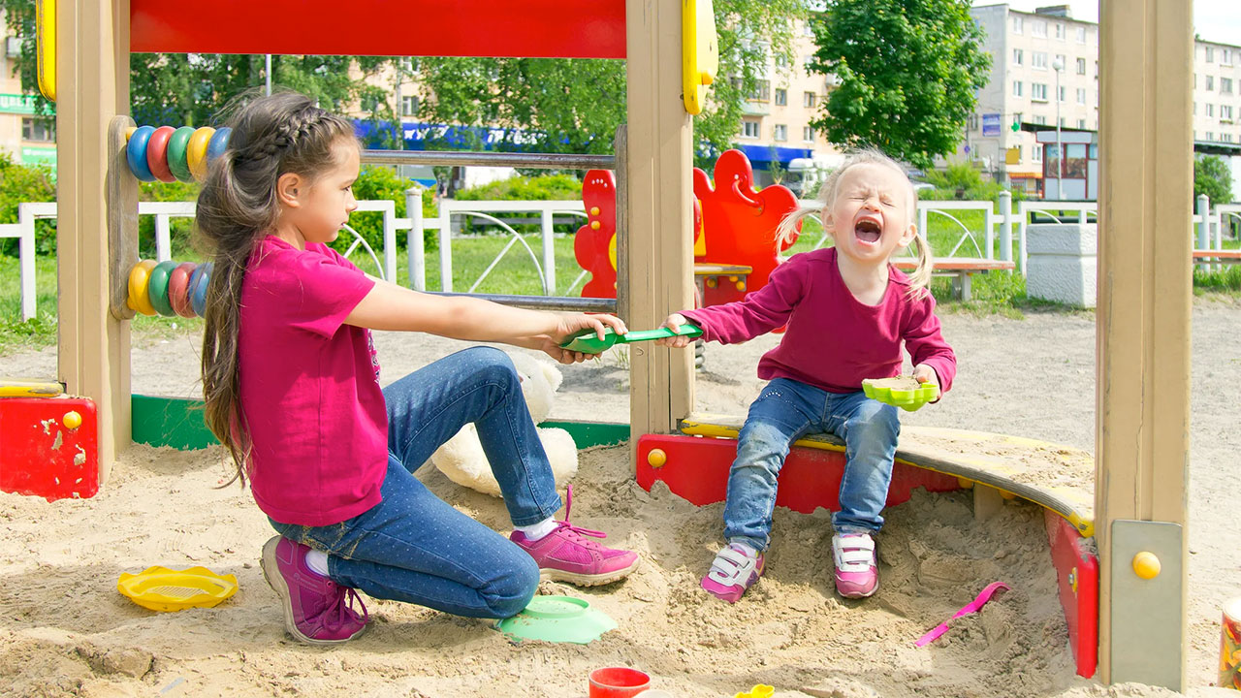
Who is doing a good and kind thing?

Slide 6
UswatUn husanah
LO1
Notes:
1. Praise your students for their good choices
2. Tell them that ‘a good/beautiful example’ is called uswatun hasanah in Arabic.
3. Repeat the phrase after you a few times along with the English meaning. Then explain:
‘Allah has put inside us a very special feeling towards good things. We automatically want to follow the best example of everything!’
Emphasize the goodness inside of us, very clearly to the young kids…this is the 1st Lesson Objective!

Slide 7
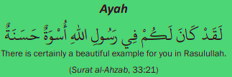
Slide 4
BE SAFE
LO2
Notes:
Now ask: ‘Who is the one person that Allah sent as the best and most beautiful example to all of mankind?’
Listen to the answers and if Rasulullah (s) is suggested, praise the suggestion generously and say: ‘Allah has told us in the Qur’an that: laqad kana lakum fi rasulillahi uswatun hasanah – There is certainly a beautiful example for you in Rasulullah.
Let’s discover a few things that make Rasulullah (s) uswatun hasanah.

Slide 8
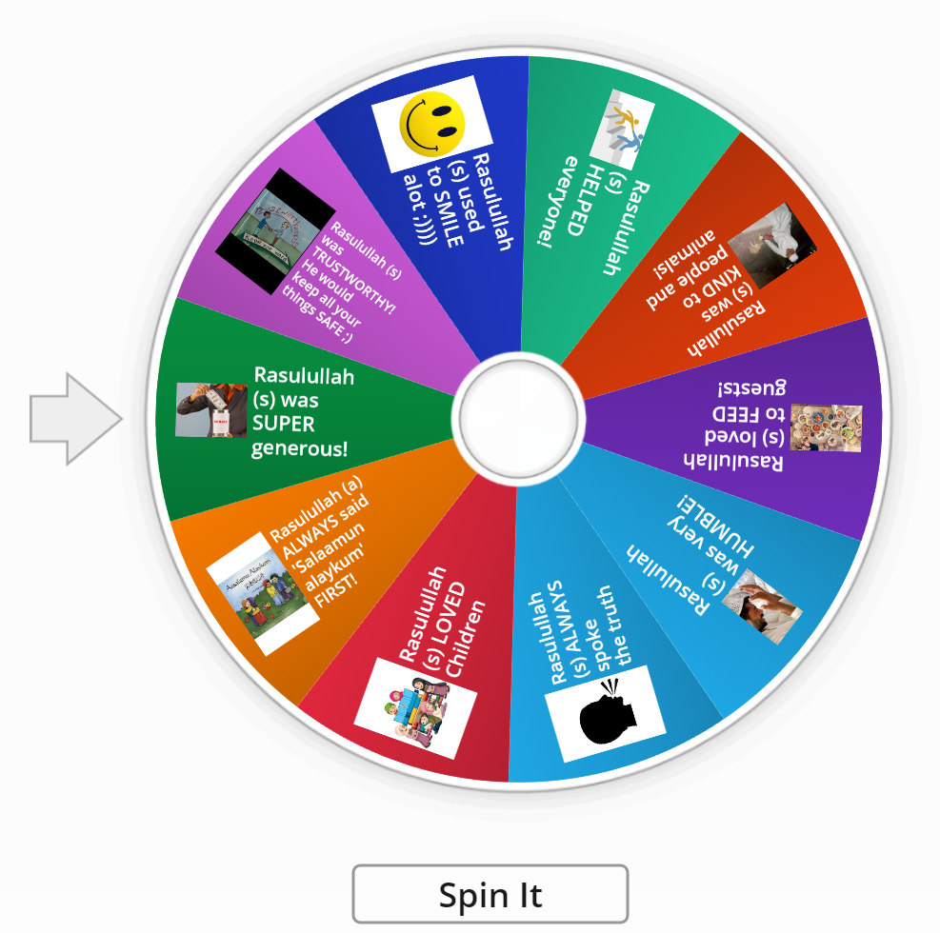
Let’s Discover a few things that make Rasulullah (s) uswatUn husanah
LO1

Slide 9
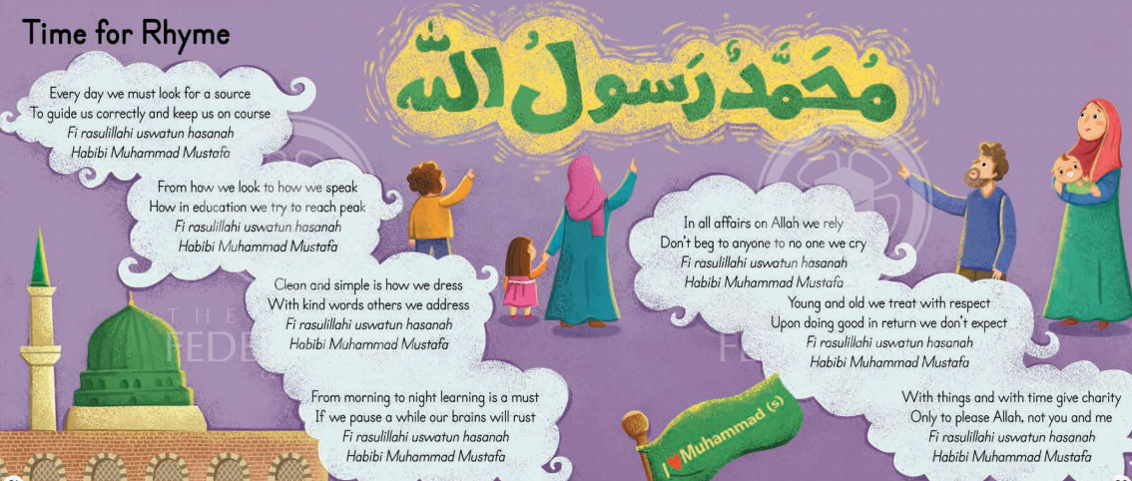
Slide 6
I want to follow uswatun hasanah by ________
Notes:
Explain to your class that you will be playing a rhyme, when the rhyme STOPS they should stand up, come close to the screen and look in the and say: ‘I want to follow uswatun hasanah by …’
For homework this week, ask the kids to play the wheel game (which you can post in google classroom) and practice uswatan husanah.

Slide 10
Slide 7
Learning Summary
To define uswatun hasanah
To show that Rasulullah (s) is uswatun hasanah
To explain different ways in which we can follow uswatun hasanah

