Slide 1


Guess who todays lesson is about?
Tarbiyah 3B05
Storybook: Kernel Grows
- - - - - - - -
Notes:
Lets Play ‘Snowman’ on white board … or on a blank screen … Ask the kids to guess the name of Lady Khadijah.

Slide 2
Yes! Lady Khadijah!
Who was Lady Khadijah?
Wife of?...
Notes:
She was the wife of Rasulullah (s)…
Congratulate them for guessing it absolutely right and tell them this is the person we will be learning about today.

Slide 3




Can we spell out Khadijah with our arms and bodies?
Lets try!
Notes:
Please see body spelling poster in the online drive (Ateka)

Slide 4
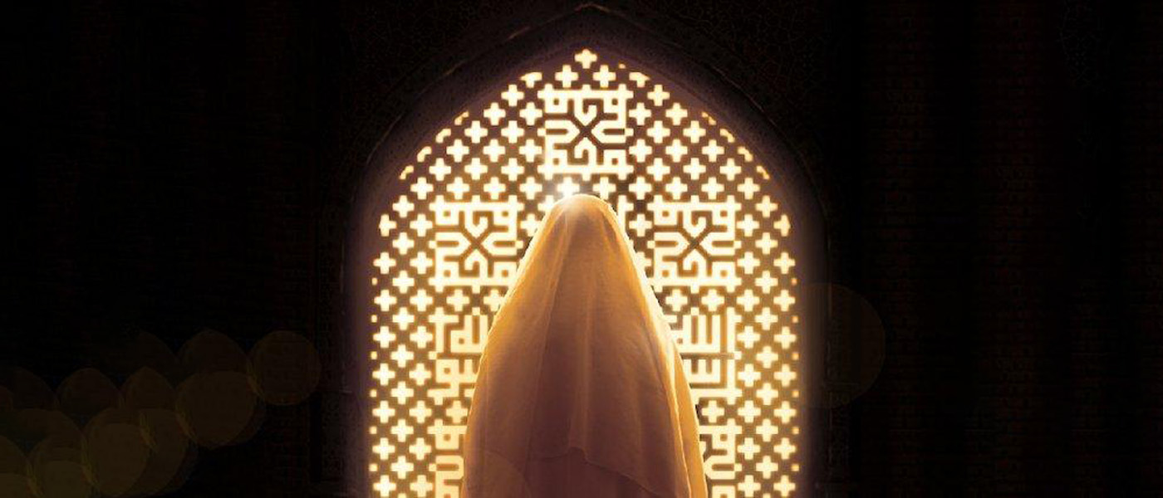
Lets Learn about Lady Khadijah

Slide 5

Notes:
Ask the children what is the picture depicting?
Remind them it is related to Lady Khadijah!
Try giving them hints. Ask them “how do you know she had a big heart” ? What did she do?

Slide 6

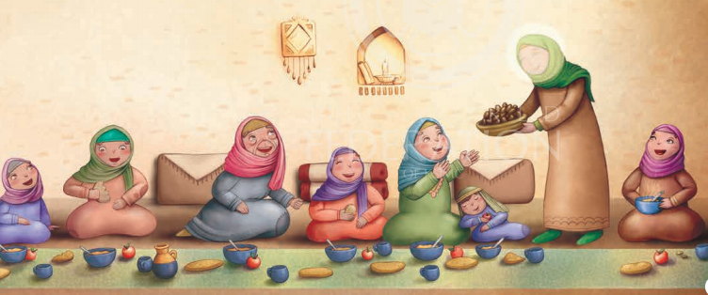
Facts abut Bibi Khadijah!
This Photo by Unknown Author is licensed under CC BY-SA
Notes:
Lady Khadijah was a very wealthy lady. Her father was a very rich businessman and when he died, she took over the family business and money. She was very clever and became wealthy. She had a very big heart. She opened a huge house and helped the poor people, the widows [ladies whose husbands have died] and also orphans.
She would help anyone who needed it. In fact, she was given the amazing title by the people of Arabia as ‘Malikat al-Arab’ – the Queen of the Arabs!
Emphasize on how she opened her house for the widows and the orphans.
She was called “ Malikat al Arab”

Slide 7
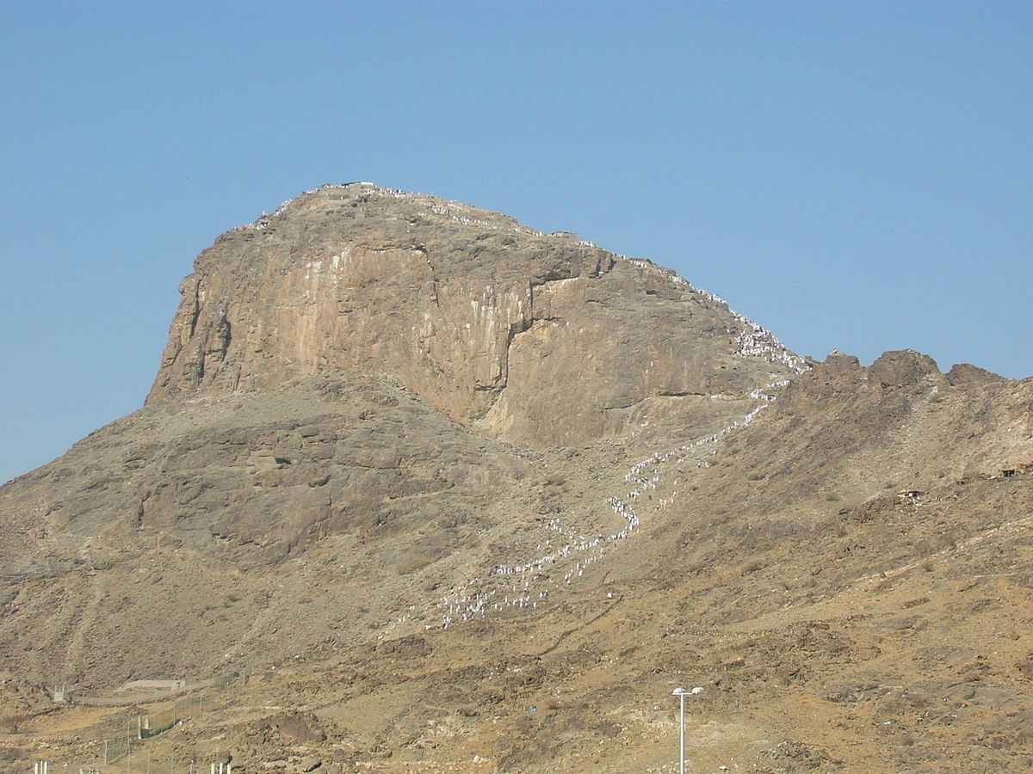
Jabal Al Noor
Notes:
Ask them “What does this picture of a mountain tells you about lady Khadijah?”
Randomly chose kids to answer. Ask them to brain storm!

Slide 8
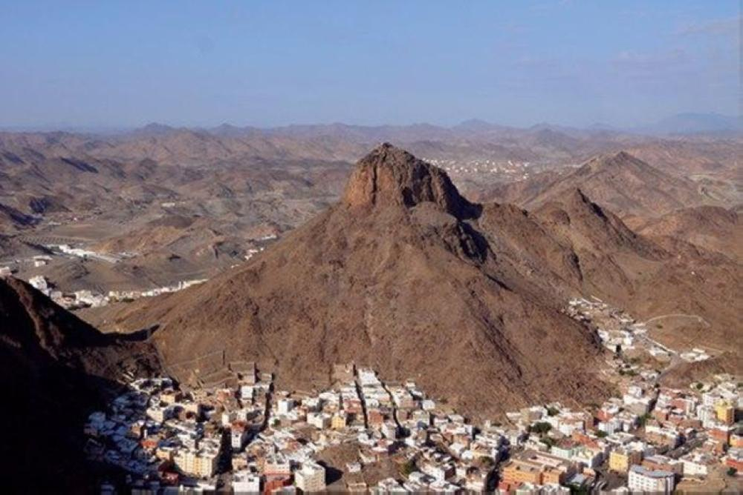
This Photo by Unknown Author is licensed under CC BY-SA
Notes:
Rasulullah (s) often used to go to a cave called Cave Hira, high up on a mountain named Jabal an-Nur and spend time thinking about Allah. Sometimes he would spend days there. Lady Khadijah would climb this very steep mountain and take food for him and make sure he was always comfortable – she loved and supported Rasulullah (s) so much.

Slide 9
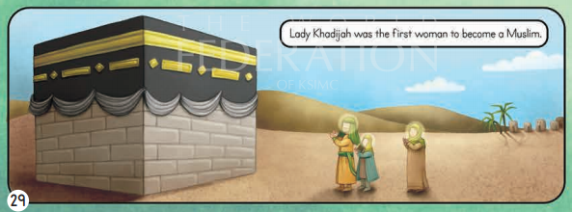
Who was the 1st woman to accept Islam?
Notes:
When Rasulullah (s) was given the message by Allah to spread Islam, Lady Khadijah was the first woman to accept this message and become a Muslim. She stood by Rasulullah (s) at all times and prayed behind him, following him in whatever he did and said.

Slide 10
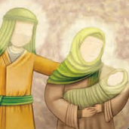
Allah blessed Rasulullah (s) and Lady Khadijah with a baby!
Notes:
Ask them what does this picture tells you?
Ask them to name their daughter.
Express immense joy when they answer “Sayyida Fatima (a)”
Tell them they are right! She was the mother of the best woman in the world <3

Slide 11
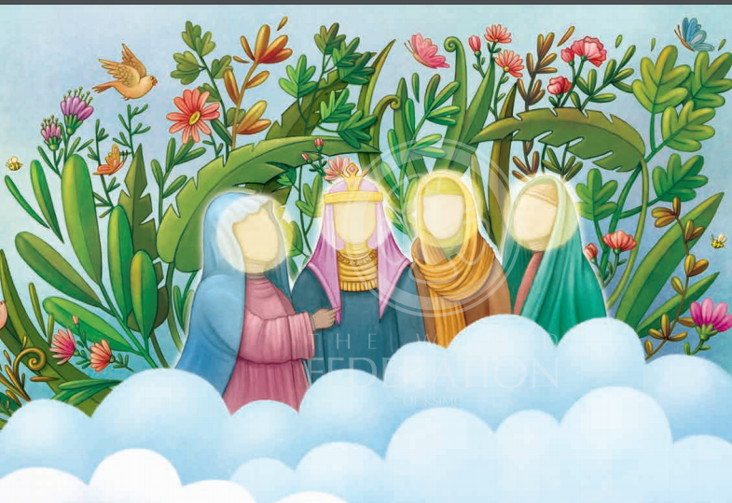
Heaven waits for 4 ladies!
Sayyidah Fatimah (a)
Lady Asiyah
Lady Maryam
Lady Khadijah
Notes:
Rasulullah (s) has said there are four most perfect ladies who will be the leaders of all the ladies in Jannah.

Slide 12
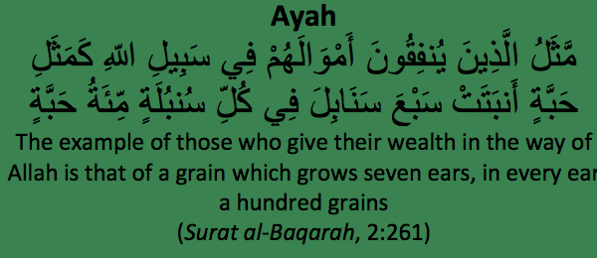
Lets try and understand this Ayah!

Slide 13
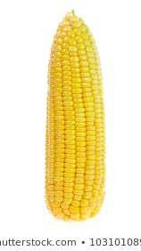
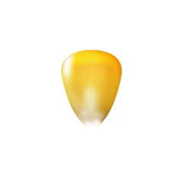
The ayah (2:261) for this lesson describes those people who spend their wealth for Allah by giving the example of a single grain of corn, growing seven ears, each ear having a hundred grains. This explains so beautifully how a small amount spent in the way of Allah can multiply as Allah is so generous.
Notes:
Show them the small grain/seed of corn and emphasize on its small size. Tell them this represents how much we spend in the way of Allah. Ask children to give examples of how we can spend in the way of Allah. Then give them the example of how the big corn. How it eventually grew into a cob . This explains how a small amount we spend in the way of Allah multiplies so much for us.

Slide 14
Strive to be like Lady Khadijah!
How can we be like lady Khadijah! Generous, Kind, Loving..
Lets think of some examples!
Get creative!

Slide 15
Super Story Time!
https://youtu.be/gms6z3BqWrw

