Slide 1
OUR RESPONSIBILITIES DURING GHAYBAH
TARBIYAH 5D-03

Slide 2
Think about someone you really love...
How do you show your love?
Can you live without them, what if they were to go out of town for a few days do you wait for them to come back? What do you feel when they return?
Can you love the people you don’t know?

Slide 3
قُل لَّا أَسْأَلُكُمْ عَلَيْهِ أَجْرًا إِلَّا الْمَوَدَّةَ فِي الْقُرْبَىٰ
SAY: ‘I DO NOT ASK YOU ANY REWARD FOR IT EXCEPT LOVE OF [MY] RELATIVES.’
SURAT ASH-SHURA, 42:23
Notes:
Allah is commanding us to love the ahlulbayt (a). Why? Perfect role models, Increases taqwa, saves us from sin, they will be there for us (shafah), learning about them will lead us to obey Allah.
This ayah is an excellent review and build up from Module 3 and 4.
When Rasulullah (s) announced his mission towards Allah, he told the people he was doing it ONLY to please Allah. Rasulullah’s (s) only asked his ummah to love his family (no worldy gain).
Companions of Rasulullah (s) went thru lots of hardship in during the early days (Shi’b)
Companions of Imam Husayn (a) showed their love for their Imam in Kerbala
TODAY we need to show our love for OUR IMAM the same way!!! It doesn’t mean that just because we can’t see them, we cannot develop love for them. There were people during the time of Prophet (a) and ahlulbayt (a) who knew them, could see them, and ask them questions but they still didn’t believe.

Slide 4
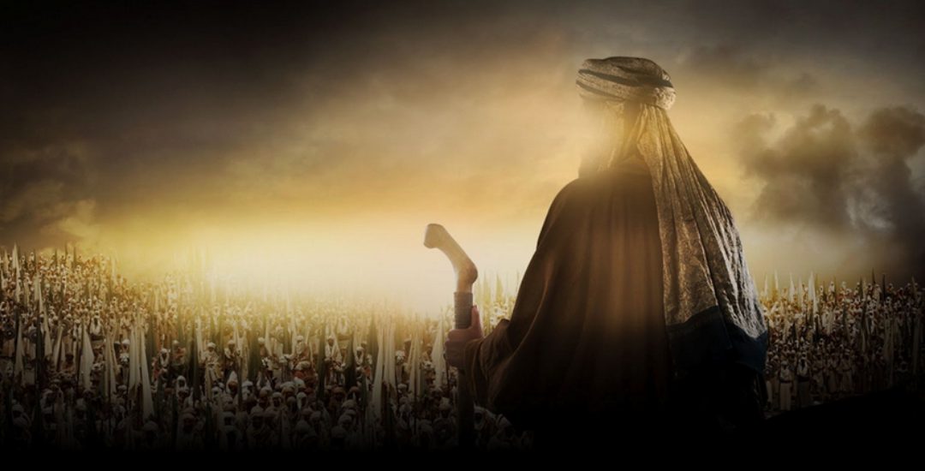
INTIDHAR
The act of ACTIVELY waiting for Imam al-Mahdi (a)
Notes:
Keyword

Slide 5
Breakout Room #1
Why is it so important to learn more about Imam al-Mahdi (a) and his mission?
Notes:
Answers from the kids:
So we can know him better
We can be ready for his reappearance[to support him]
We will be aware of the message that he will spread once he reappears on this world [what he is going to do]
So we will get to know him better and strengthen our bond with him [increase our love for him] in this world before he reappears

Slide 6
Breakout Room #2
What are some actions you can do while Imam (a) is in ghaybah? Give specific examples!
Notes:
Answers from the class -
we should do all our wajbaat in order to be closer to Allah (swt)
we should have knowledge so we understand our deen more
we should develop our character better so then when the Imam comes, we could join his army
we should teach others about islam, so they can prepare for the reappearance of the imam
we should pray for the Imam because it will give the imam the best blessing and for him to be safe.
we should perform good deeds so we get sawaab and don’t get farther away from islam
we can prepare the ground for his mission by reforming our society (making it better).
we should pray for his reappearance
We need to work hard in school as well

Slide 7
Breakout Room #3
Imam al-Mahdi (a) has said "My benefit (to the people) during my occultation is similar to that of the sun, when it disappears from sight behind the clouds." What does the above hadith mean to you?
Notes:
Answers from the kids -
In this hadith, Imam Mahdi is saying that when the sun is behind the clouds, we cannot see it, but it doesn’t mean it is not there. Same concept, Imam Mahdi, is in Ghaybah and we cannot see him, but he is still there and we have to believe he is there.
We have to wait for him in Ghaybah because he is there waiting to come out.
While he is in Ghaybah, Imam Mahdi is giving us a chance to prepare for him by:
Taking time to learn more about him
Taking time to strengthen our Iman.
Just because we can’t see him, doesn’t mean he is not helping us. Imam is praying for us.

Slide 8
Breakout Room #4
How can we love Imam al-Mahdi (a)? List 3 ways.
Notes:
Answers from the kids –
We can pray for him (keep him safe, to come out of ghaybah)
We can think of him (write him letters...)
We can get ready for him and share our knowledge about him so that more people are ready for him to come.

Slide 9
Breakout Room #5
What are some things that make it hard to be a practicing Muslim when the Imam (a) is in ghaybah?
Islam
Notes:
Answers from the kids -
you don’t know if he’s really there → its about faith
when you’re doing namaz, you’re always asking Allah to see him but then lose faith
sometimes it’s easy to believe that he’s not there because he’s not showing signs that he’s there
Worldly distractions like social media, wearing western clothing, friends
Shaytan can take advantage of you

Slide 10
Homework
Suppose the Imam (a) visited you and you had a chance to talk to him, what would you tell him?
This assignment is personal - you may choose to share it with me or not.

