Slide 1
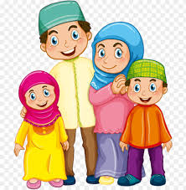
WE LOVE OUR PARENTS
LESSON 7A 02

Slide 2
LESSON OBJECTIVES
To recognise the importance of parents in their lives
To recall a du’a that children can recite for their parents
To select two ways in which to please their parents

Slide 3
The Quran says….
وبِالوالدیْن إِحساناً
Be kind to your parents
(Surat al-Baqarah, 2:83)

Slide 4
WALIDAYN
والدین
Parents

Slide 5
IHSAN
إحْسان
Goodness

Slide 6
UMM
أم
Mother

Slide 7
LETS IMAGINE…
Notes:
Begin your lesson by asking the students to close their eyes and picture mum and dad.
Ask them to imagine them both giving you a hug, a group hug. It is such a lovely place to be. Ask children to open their eyes and now tell them about how, parents are like a circle of blessing for us. They care for us and protect us all the time.
(Activity 1 from the Teachers Guide)
Ateka’s notes: Make sure all the kids are closing their eyes, then at the hug part – they are wrapping their hands around themselves (self hug)

Slide 13
How Can You Please Your Parents?
Notes:
Ask students what they can do to please their parents, and write them on the blue boxes. Or ask them what they do in return for their parents and write those down on the board (example answers: hugs and kisses, obey them, be kind, share stories, play together, etc.)
The blue boxes are text box’s so double click to write on them

Slide 14
Now lets repeat
وبِالوالدیْن إِحساناً
Be kind to your parents
(Surat al-Baqarah, 2:83)
Notes:
Repeat the ayah once again.

Slide 15
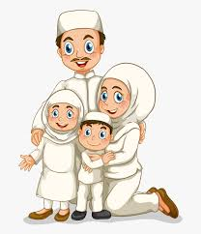
TIME FOR A RHYME!
Notes:
Click on the speaker to play the audio, if it doesn’t work, it can be downloaded from the mce website

Slide 16
STORY TIME!!
https://madrasahonline.org/lessons/7a02-we-love-our-parents/
Notes:
Use MCE website to access book
Ateka’s Notes : If you are short on time, or children are restless, read the adorable ahlulbayt story, instead of the main story about the owl….

