Slide 1
My Siblings and Me
Tarbiyah 7A03

Slide 2
اِنَّ اللّٰهَ يَاۡمُرُ بِالۡعَدۡلِ وَالۡاِحۡسَانِ وَاِيۡتَآىـئِ ذِى الۡقُرۡبٰى
For sure, Allah tells us to be fair and kind, and giving with our family. (Surat an-Nahl, 16:90)
Notes:
Begin class with saying Bismillah and recite the Ayaat slowly. Then, recite the English. Ask the children why they think this Ayaat is important.

Slide 3
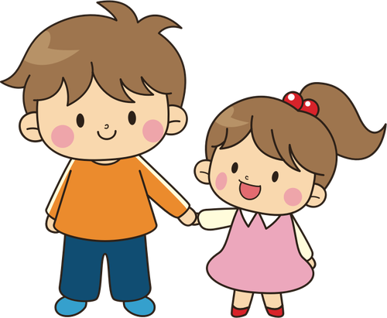
Today’s Lesson Objectives
To recognize the importance of having a good relationship with siblings.
To identify relationships with siblings in history.
To reinforce the characteristics of a good sibling.
Notes:
Read lesson objectives in easier language for the children to understand.

Slide 4
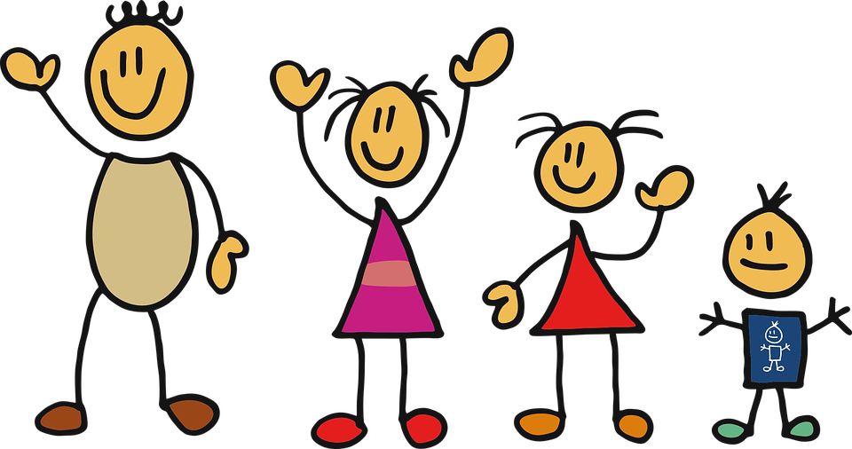
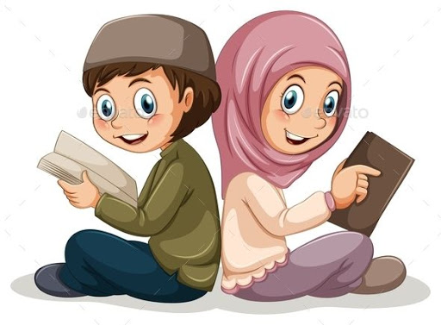
How Many of You Have a Sibling?
VOCABULARY
أخي - Akhi - “my brother”
أُختي - Ukhti - “my sister”
Notes:
Ask the children about their own siblings (how many, older or younger, how do they get along with each other) and introduce vocabulary.

Slide 5
What Makes a Good Sibling?

Slide 6
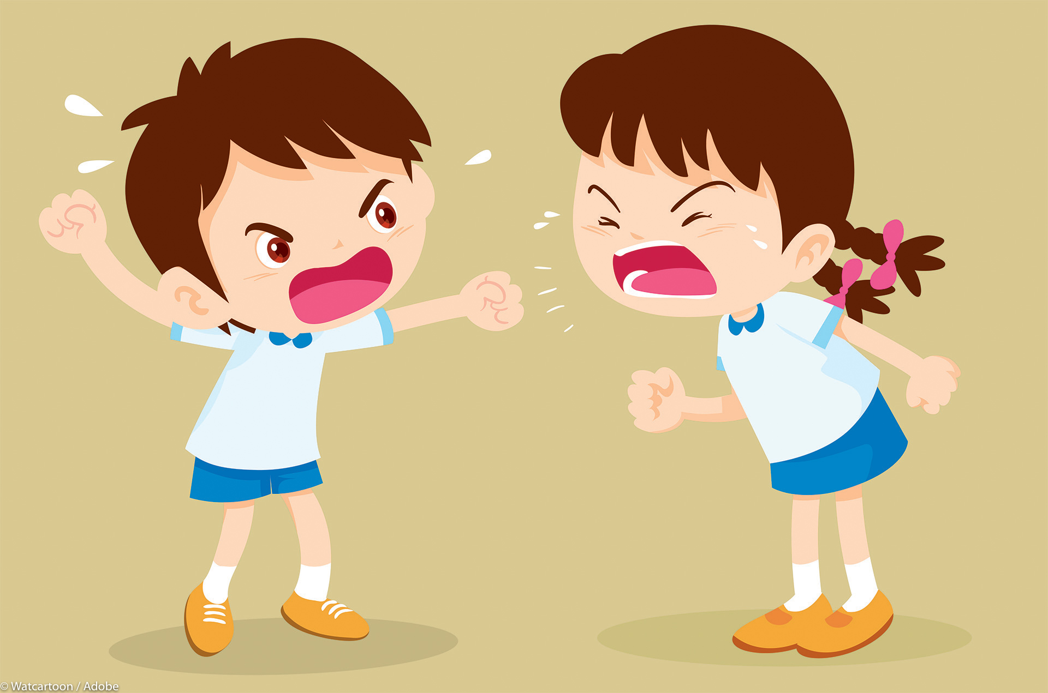
Notes:
Ask if this is a good example of good siblings. The answer is no because they are yelling and fighting with one another. Demonstrate how one should talk calmly with their sibling.
Ateka’s notes - just to add the kinesthetic piece - before you start playing the game - tell them they all need to make a sad face if its a bad example, and a big smiling/laughing face if its a good example

Slide 7
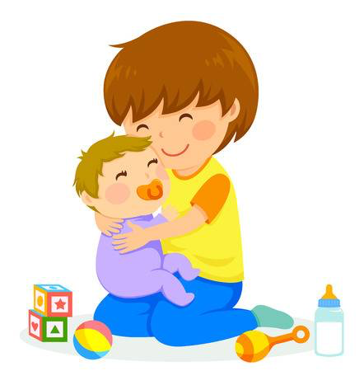
Notes:
Ask if this is a good example of good siblings. The answer is yes. Ask what the big brother is doing. Explain how it is important to show our siblings and family we love each other. We can do this by giving hugs.

Slide 8
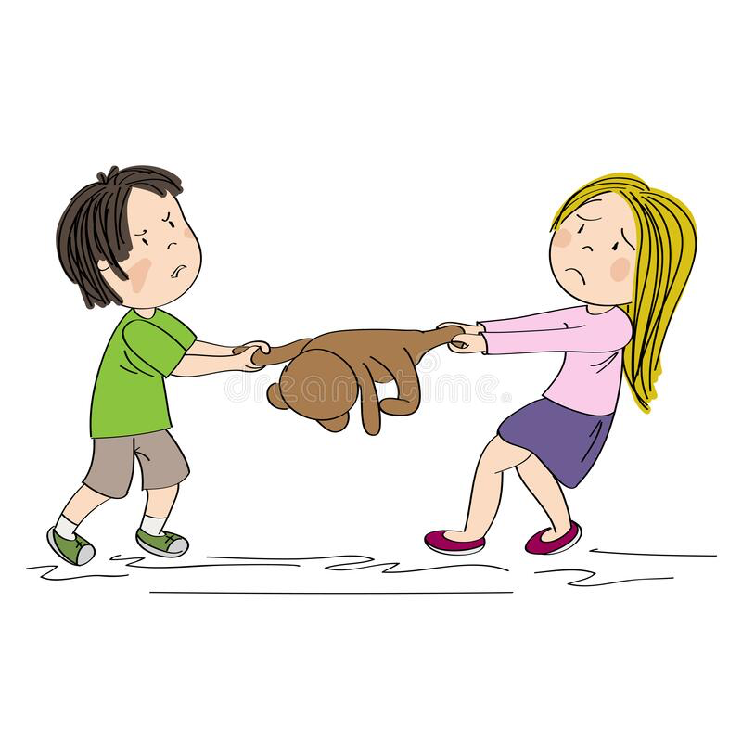
Notes:
Ask if this is a good example of good siblings. The answer is no because they are fighting over a toy. Explain how we should share with our siblings.

Slide 9
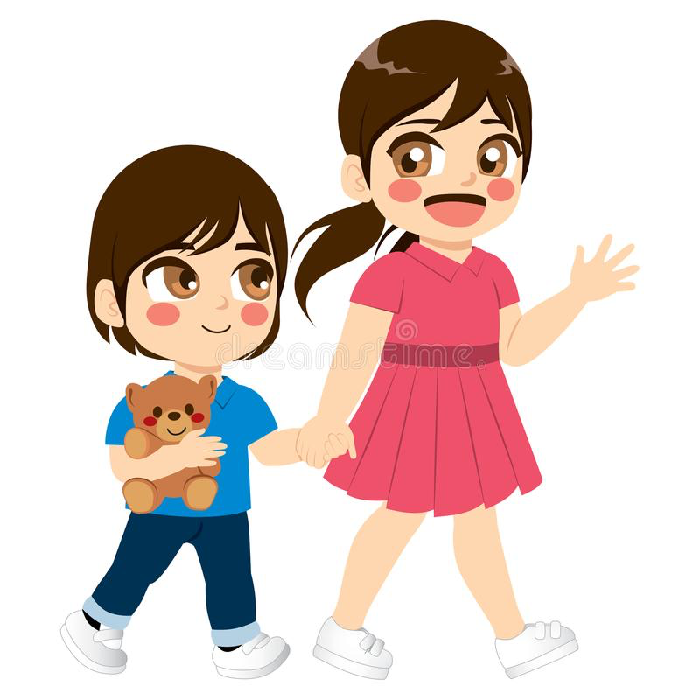
Notes:
Ask if this is a good example of good siblings. The answer is yes. The older sister is holding the little sister’s hand and guiding her. Explain how we should help our younger siblings.

Slide 10
Who Are Siblings in Islam?
Notes:
Kids may have trouble answering and need many hints. Give hints about our Imams (Imam Hassan (AS) and Imam Hussein (AS).

Slide 11
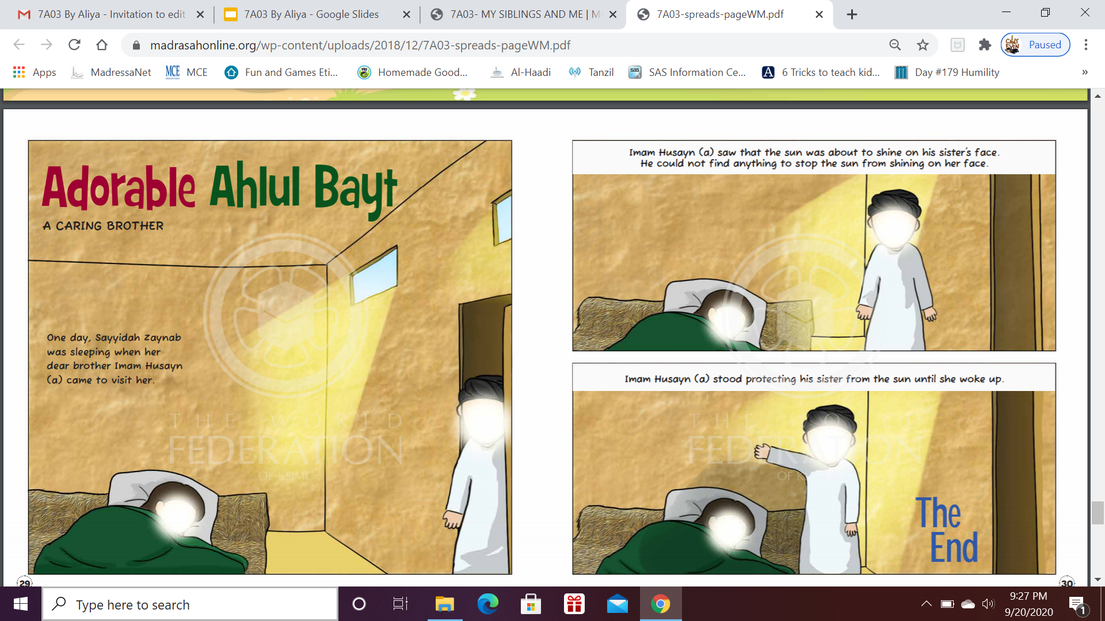
Notes:
Imam Hussein (AS) and Bibi Zainab as one example.
Ateka’s notes - please be very careful when talking about Karbala, and battle, and killing, and swords, etc....children are VERY sensitive. So I changed the story to the one from the storybook for this lesson.

Slide 12
Activity Time!
Card-Making
1 thing your sibling does that makes you happy.
1 activity you love to do together.
1 way you can work together to get closer to Allah (SWT).
We are going to be making beautiful cards for our siblings.

