Slide 1
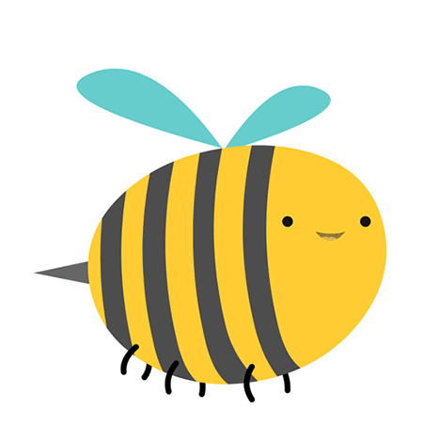
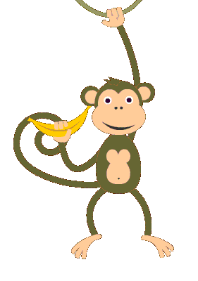
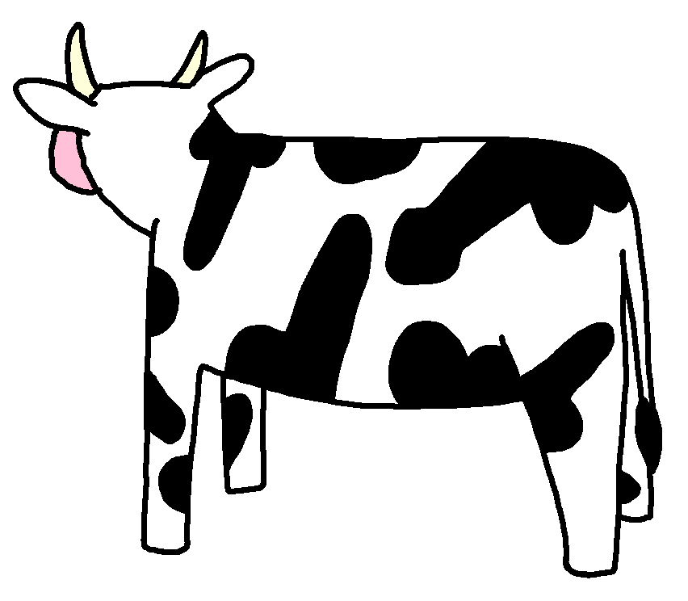
Animals in the Quran

Slide 2
وَالْأَنْعَامَ خَلَقَهَا ۗ لَكُمْ فِيهَا دِفْءٌ وَمَنَافِعُ وَمِنْهَا تَأْكُلُونَ And He created the cattle for you; you have in them warm clothing and many advantages. Surah Nahl (16:5)

Slide 3
Guess the sound of the animals.

Slide 4
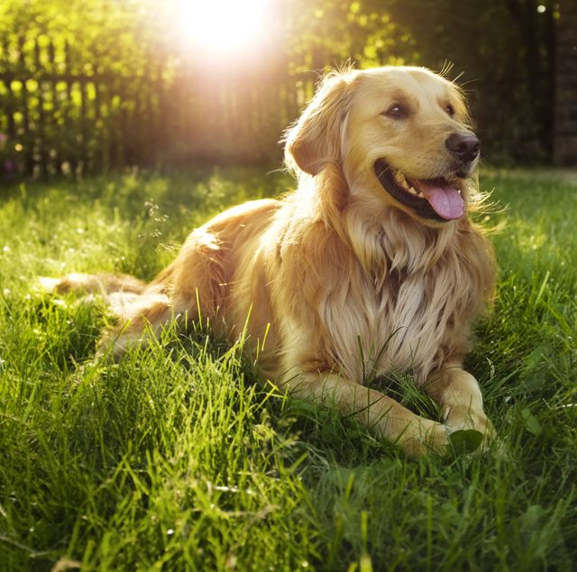
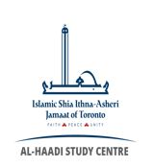

Slide 6
This Photo by Unknown Author is licensed under CC BY-SA

Slide 8
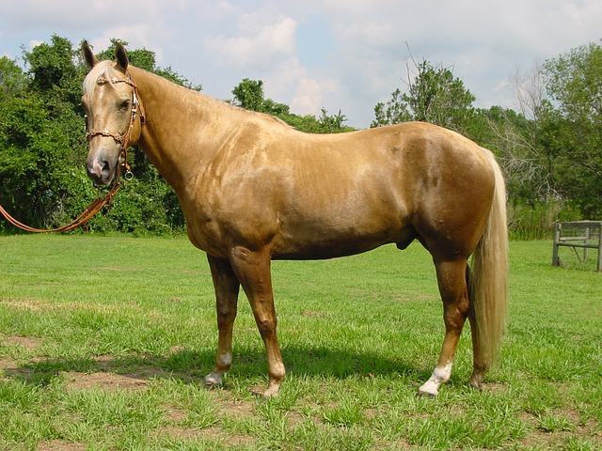

Slide 10
This Photo by Unknown Author is licensed under CC BY-SA

Slide 11
COW - بقرة
BEE – نحل
SPIDER - عنكبؤت
ANT - نمل
Notes:
You could sing the rhyme “Old Mcdonald’s had a farm or Prophet Nuh’s Ark”, instead of saying English names you could say the Arabic names!

Slide 12
BEE – نحل
SPIDER - عنكبؤت
COW - بقرة
ANT - نمل
Notes:
Match the word to the correct animal, and ask them if they know any advantages of these animals

Slide 13
https://madrasahonline.org/lessons/7a04-animals-in-the-quran/
Notes:
I think it would be a great idea to cover yourself with a big wooly blanket before you read this story (Ateka)

Slide 14
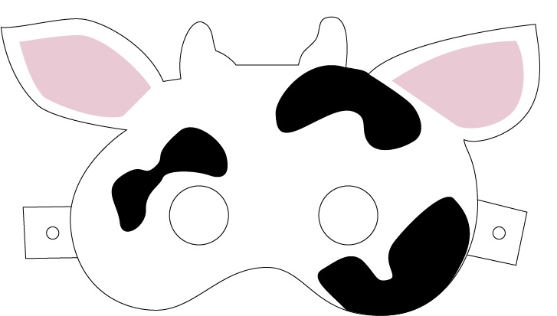
Make a COW mask! https://madrasahonline.org/wp-content/uploads/2018/11/7A04_EXT1_animal-mask_cow-1.pdf
Notes:
In class activity - students will be making the craft together

